Slide 1
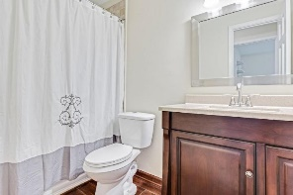
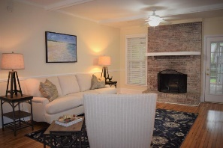
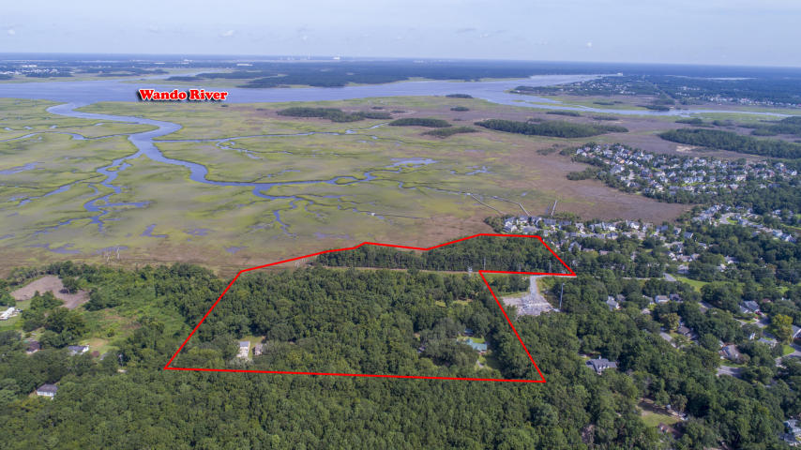
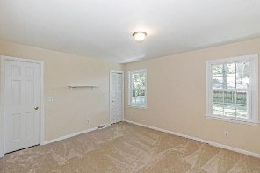
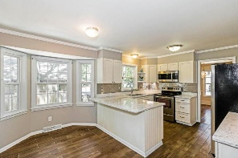
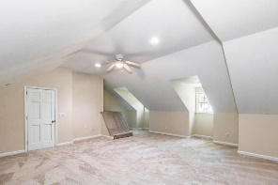
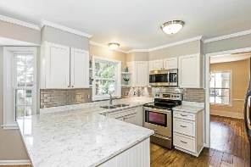
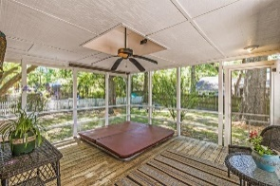
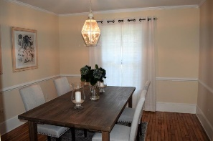
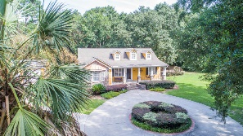
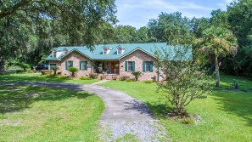
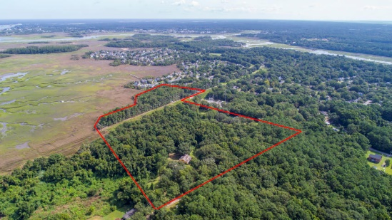
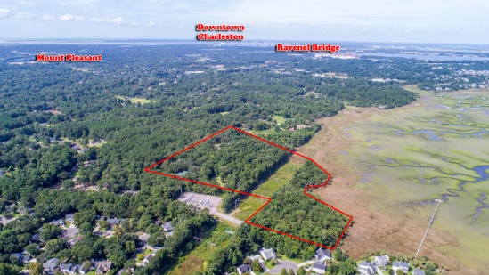
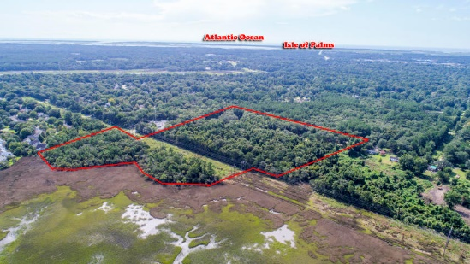



Prime Development Tract in Mt. Pleasant! Price Reduced 600K!
00 Latroy Avenue
Christ Church Parish | MLS# 18023414 | $8,900,000
A stunning site for future development! Marshfront, majestic oaks, and a parklike setting! This property is comprised of a total 20 +- acres in central Mount Pleasant off Long Point Rd, located close to shopping, schools, and restaurants. Zoned S3 Residential (Charleston County) with Sewer at site.
Also included in the sale are plats, TMS# 556-00-00-430 (1770 Latroy Ave) 1.83 acres, with a 3800 sf house, built in 1999; and TMS# 556-00-00-495 (1722 Latroy Ave) 1.05 acres with a 1500 sf house with a detached 3 car garage built in 2009.
A beautiful property waiting for the new owner to create their masterpiece.
Elaine Nugent
(843) 330-7044
enugent@carolinaone.com
John Nugent
(843) 304-2061
john.nugent@carolinaone.com
nugentknowsrealestate.com
Carolina One Real Estate | 628 Long Point Rd | Mt Pleasant, SC 29464

