Slide 1
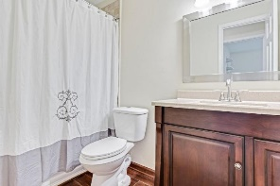
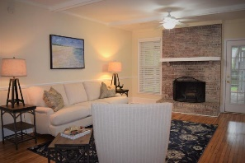
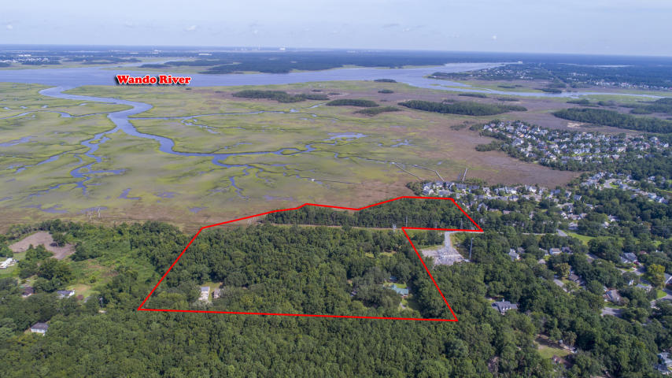
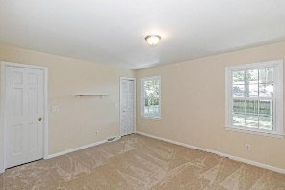
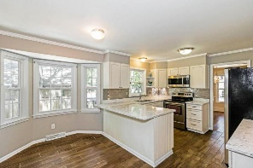
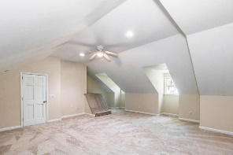
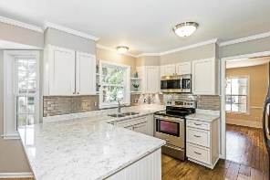
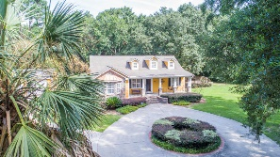
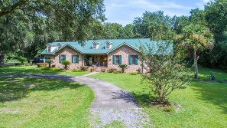
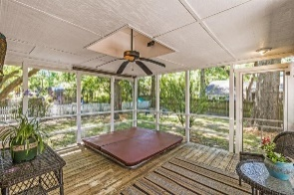
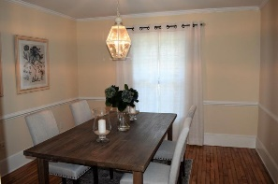
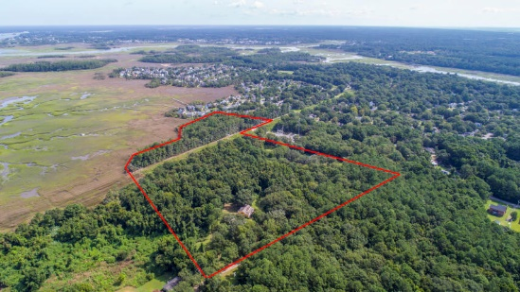
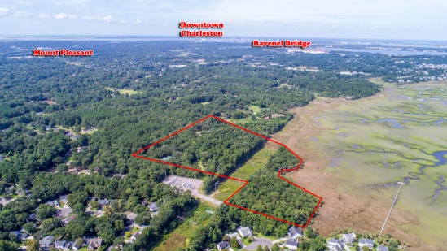
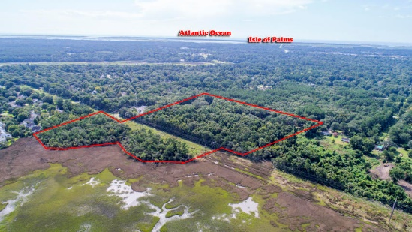



Prime Development Tract in Mt. Pleasant!
Back on the Market!
00 Latroy Avenue
Christ Church Parish | MLS# 18023414 | $9,500,000
A stunning site for future development! Marshfront, majestic oaks, and a parklike setting! This property is comprised of a total 20 +- acres in central Mount Pleasant off Long Point Rd, located close to shopping, schools, and restaurants. Zoned S3 Residential (Charleston County).
Also included in the sale are plats, TMS# 556-00-00-430 (1770 Latroy Ave) 1.83 acres, with a 3800 sf house, built in 1999; and TMS# 556-00-00-495 (1722 Latroy Ave) 1.05 acres with a 1500 sf house with a detached 3 car garage built in 2009 with sewer at site.
A beautiful property waiting for the new owner to create their masterpiece.
Elaine Nugent
(843) 330-7044
enugent@carolinaone.com
John Nugent
(843) 304-2061
john.nugent@carolinaone.com
nugentknowsrealestate.com
Carolina One Real Estate | 628 Long Point Rd | Mt Pleasant, SC 29464

