Slide 1
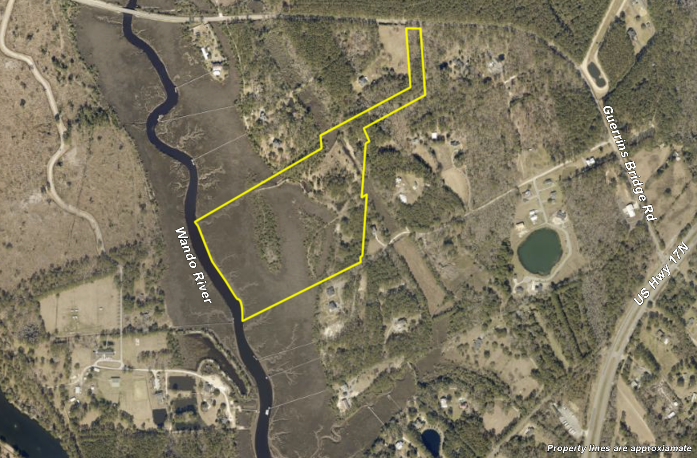
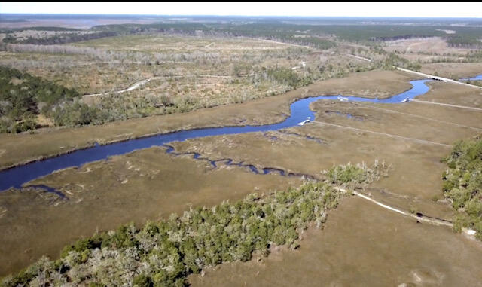
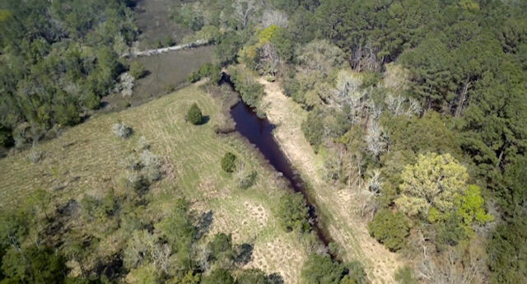
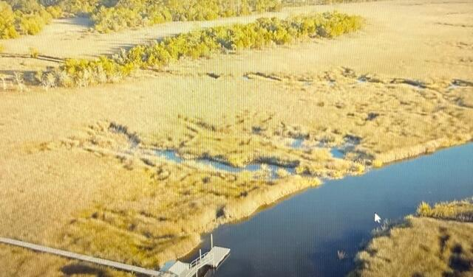


00 Cedar Plantation Lane Awendaw, SC 29429 | MLS# 23006567 | $4,400,000
Awendaw on the River
5 Lots Left
To Choose From
DEEP WATER!! 34.85 ACRES ON THE WANDO RIVER!!
Dock and Septic permits in hand and site is ready to build on now!! 6 ft OF WATER AT LOW TIDE! This property offers panoramic views of its tranquil riverfront setting, the privacy that you long for, and fabulous views of one of the most beautiful waterfront sunsets in the Lowcountry! Located less than 10 minutes from Costco, Wando High School, and Roper Hospital, you will feel worlds away! Adorned with magical moss draped Oak trees and lush Palmettos, this peaceful paradise can be all yours! Welcome to life in the Lowcountry, where you can swim, fish, boat, or just relax ....your options are endless!
FEATURES
5 Lots remaining - ranging from 3 to 10 acres
Price ranging from $625,000 to $925,000
Dock and Septic Permits in hand!
6-8 ft Water at Low Tide
Close to everything, feels worlds away!
https://www.youtube.com/watch?v=eMkxq8Xdfbs
Wendy Arnsdorff
843-364-8619
wendy.arnsdorff@carolinaone.com www.wendyarnsdorff.com
Carolina One Real Estate :: Mt. Pleasant North Office :: 2713 N Highway 17 :: Mt. Pleasant, SC 29466

