Slide 1
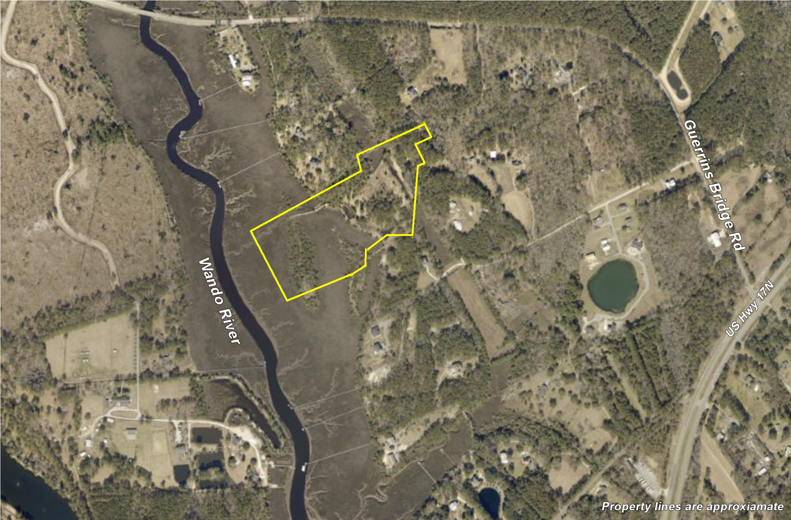
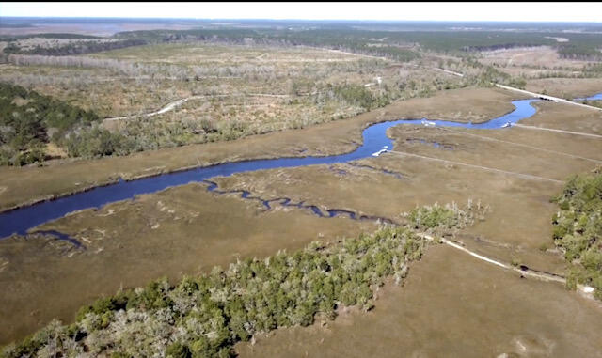
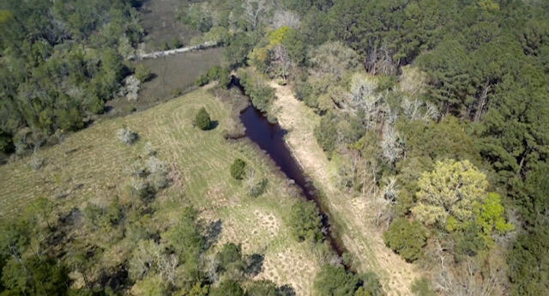
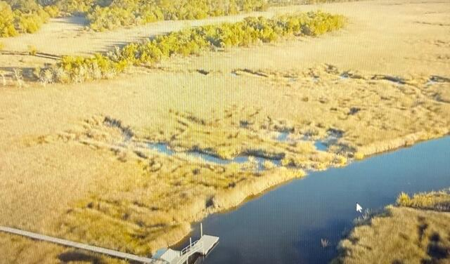


00 Cedar Plantation Lane Awendaw, SC 29429 | MLS# 23013425 | $1,490,000
Awendaw on the River
Two Lots Combined!
16 Acres of Deep Water Paradise!
The entrance of this property is lined with magical moss draped oak trees with long views over waving marsh, both saltwater AND freshwater ponds, and even your very own little private island! This site offers panoramic views of a tranquil riverfront setting and fabulous views of one of the most beautiful waterfront sunsets in the Lowcountry! Located less than 10 minutes from Costco, Wando High School, and Roper Hospital, these lots provide the privacy you long for, yet feels worlds away! Welcome to life in the Lowcountry, where you can swim, fish, boat, or just relax ....your opportunities are endless!
FEATURES
Dock and Septic Permits in hand!
Saltwater and Freshwater Ponds
Your very own Private Island!
6-8 ft Water at Low Tide
Close to everything, feels world's away!
https://www.youtube.com/watch?v=eMkxq8Xdfbs
Wendy Arnsdorff
843-364-8619
wendy.arnsdorff@carolinaone.com www.wendyarnsdorff.com
Carolina One Real Estate :: Mt. Pleasant North Office :: 2713 N Highway 17 :: Mt. Pleasant, SC 29466

