Slide 1
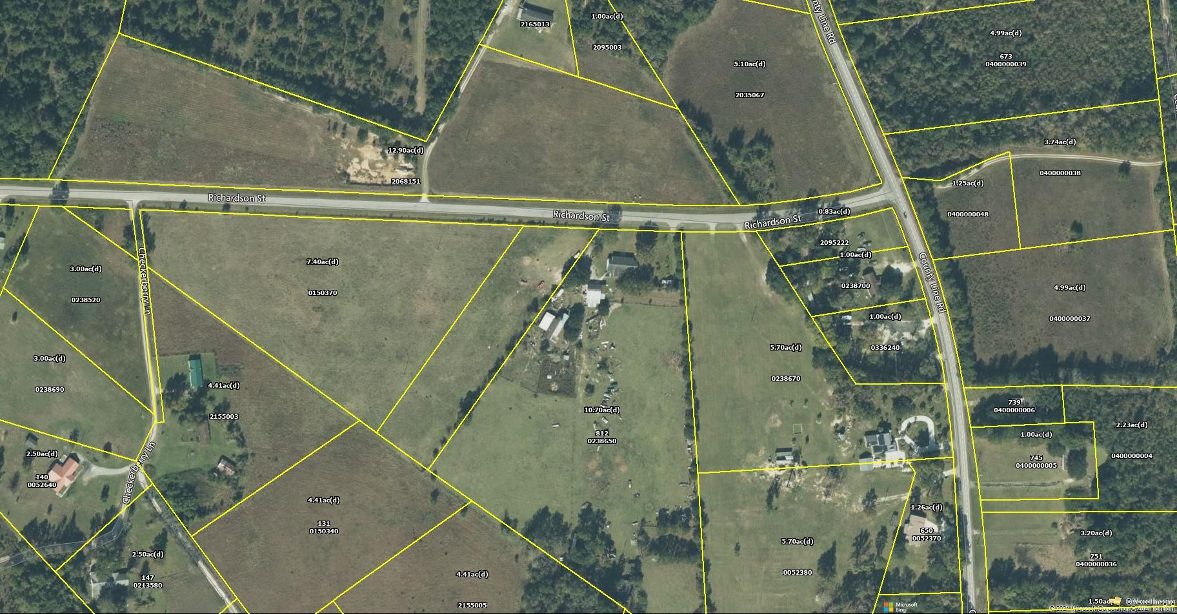
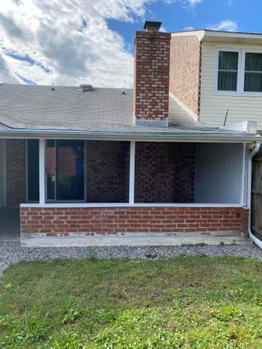
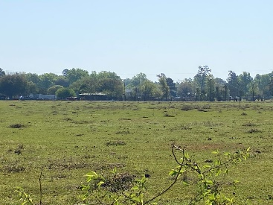
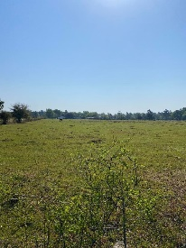
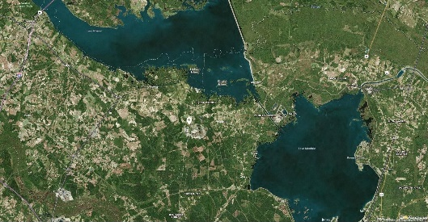
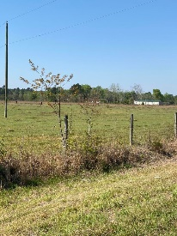
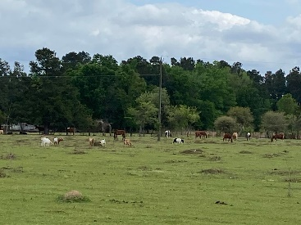


00 Richardson Street
Eutawville, SC 29048 | MLS# 21009465 | $62,000
Open House Saturday
12:00 until 4:00
Beautiful 7.4 Acre Lot Near Lake Marion & Moultrie
Open House Saturday 8/24/19
12:00 until 4:00
Beautiful level and high 7.4 Acre lot ready for you to build your new home. Near Lake Marion, 5.5 miles(8 min) to Bell's Marina. 30 minutes to Volvo. The property sits on a paved road and the lot is beautifully maintained. Currently used for horses and grazing.
James Hopkins
(843) 708-5930
James.Hopkins@AgentOwnedRealty.com
AgentOwned Premiere Group
1800 Trolley Rd
Summerville, SC 29485

