Slide 1
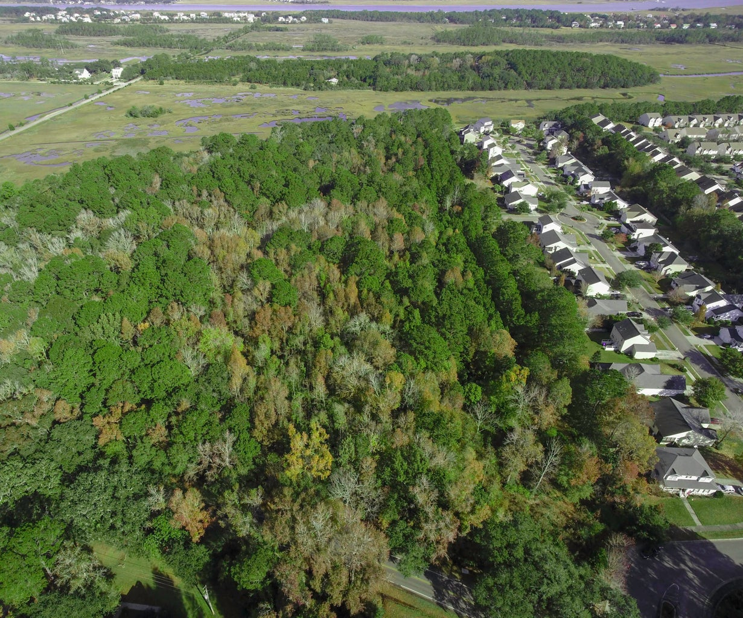
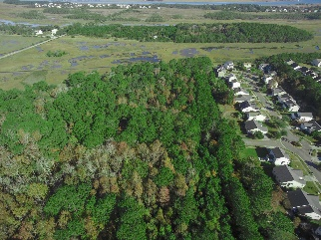
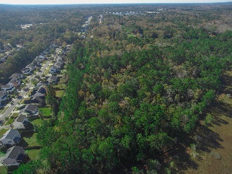
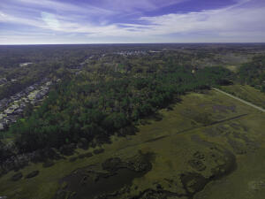
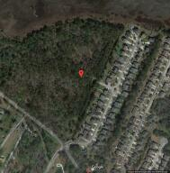
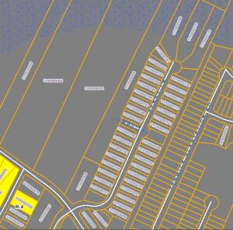
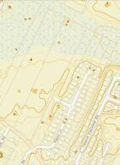
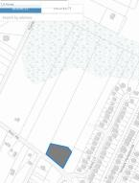
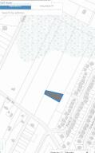
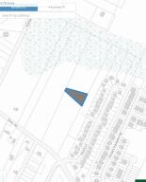
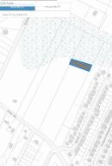



10+ ACRES WITH OVER 300ft MARSH FRONTAGE!
00 River Road
Rushland
Johns Island, SC 29455
MLS# 23017354
$650,000
10.5 Acres
Attention Developers and Builders: UP TO 35 LOTS! Sewer at the site! This lot is annexed into the City of Charleston and is zoned SR-1, meaning 4.8 dwellings per acre OR 24 dwellings per 5 acres. This would make a great second phase of ''The Bend'' subdivision, a gorgeous single estate home or multiple homes for a Charleston getaway. The estimated clearing for the land is about $30,000 - $40,000, you will also need fill for the roughly 5 acres of wetlands, plus permit expenses should you want to maximize the amount of homesites. New Homes have the potential to sell for upwards of $500k OR MORE!
This parcel totals 10.5 acres and has over 300ft of marsh-front at the back side of the lot! This property contains a few gorgeous Oaks that would look great for anyone looking to build a home or subdivision!
This parcel is also great for a family looking to build multiple homes for all family members. With SR-1 zoning (see below) in place, the home sizes could be endless!
Nick Mazzilli
(843) 640-5575
nick@nickmcharleston.com
nickmavencharleston.com
Maven Realty
2180 McMillan Ave
#71672
Charleston, SC 29405

