Slide 1
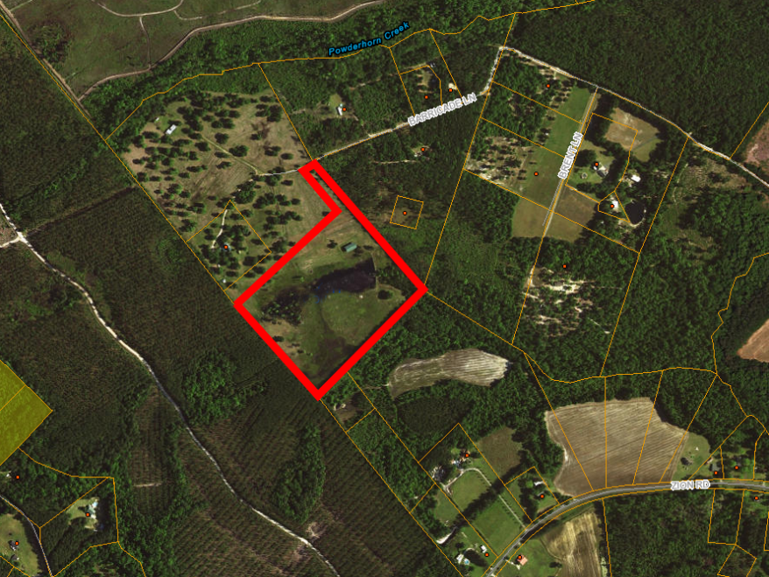
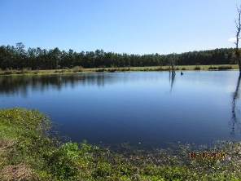
20 Minutes From Summerville
Barricade Lane
MLS #17029706 - 25 Acres - $219,000
MLS #17029716 - 20 Acres - $179,000
MLS #17029714 - 15 Acres - $149,000
MLS #17029713 - 10 Acres - $129,000
MLS #17029711 - 5 Acres - $79,000​
$40,000
Price Reduction!
This property is absolutely gorgeous, it contains a lake and open fields and a small area of trees. The property will be subdivided from a larger parcel that currently has an upscale log home and fenced area for horses.
Very private. The property has an abundance of Deer and Turkey. It even has a pole barn (with open sides) previously used by previous owners for RV and other vehicles. Lots of potential to convert into many different uses including a residence. Property has 4 Perk sites.
Rick Willis
843-327-3017 Rick@RickWillis.com The Group, LLC

