Slide 1

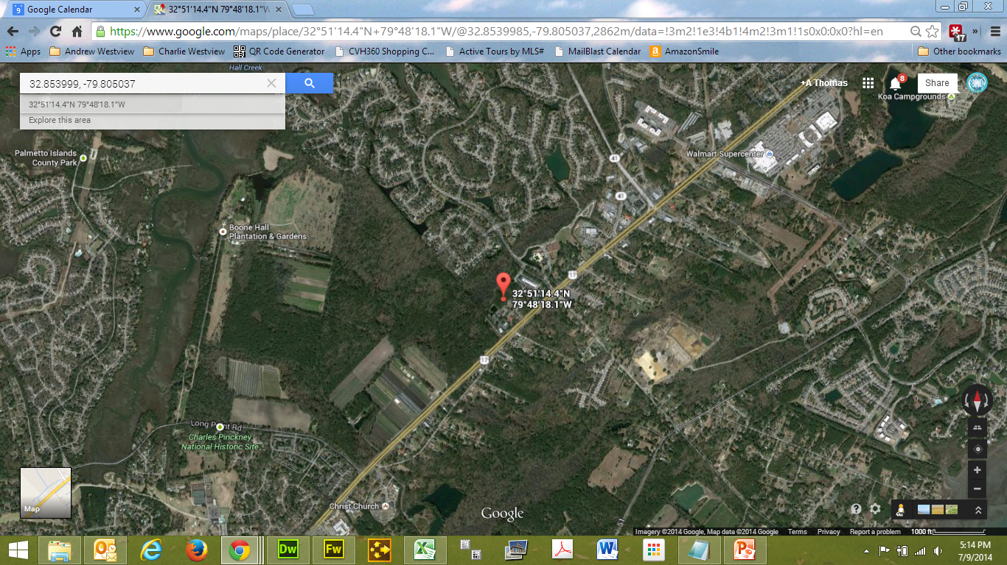
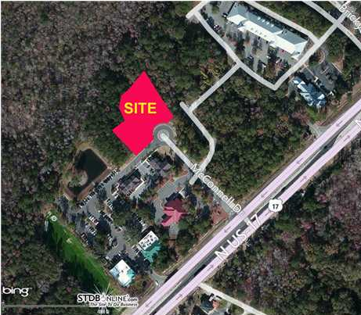


PRIME COMMERCIAL LOCATION CONNECTED TO BRICKYARD PLANTATION
Office Professional District (OP) Land For Sale in Mount Pleasant. 1.94 Acres just off Highway 17 North which is easy to access from the north or south. Connected to Brickyard Subdivision via The Shoppes at Brickyard. Located in the Brickyard Professional Center where Medical/Dental Services are nearby. In between East Cooper and Roper Hospitals. Current owner is a developer that is also marketing this property location as a build to suit lease/sale. Lease rates is 17 NNN and sale is $190 psf.
Acres: 1.940
Address: BRICKSIDE LN
Area: CHS-Mt.Pleasant North of IOP Connector
Category: details
City: MOUNT PLEASANT
County: Charleston
Listing ID: 1224885
Listing Price: $849,000
Property Name: BRICKYARD PROFESSIONAL CENTER

