Slide 1
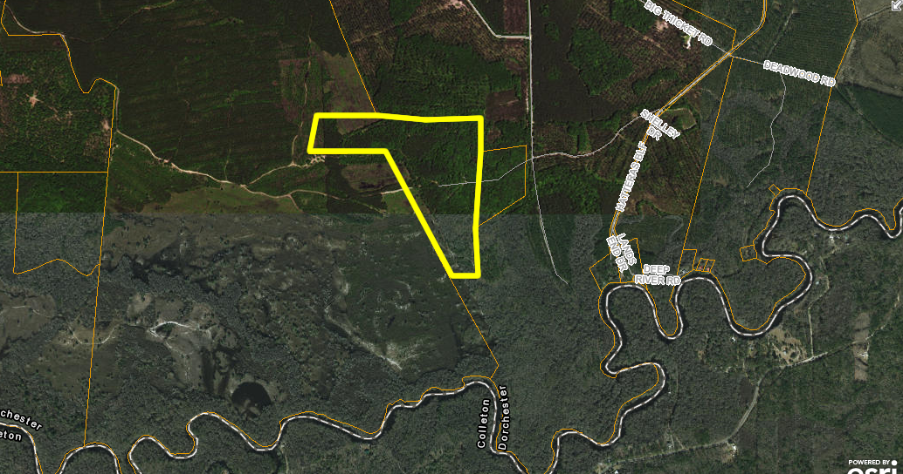
Beautiful Home in Paddock Point
PRICE REDUCED TO SELL QUICK
0 Bridge Road
St George, SC 29477
MLS# 17020559
Reduced to $205,000
This 64.7 acres of raw land is perfect for you to build your true dream home on. You are close to the Edisto River. This area is great for outdoor activities. All the fishing and hunting you can dream of. On this 64.7 acres track their are large mature Pines and Oak tree's which is perfect for the avid hunter! You can sit on your front porch and watch the deer, turkey and wild hog's roam around. This is country living at it's best!
Kenold Claude
kclaude76@gmail.com | (315) 486-2253 | www.mkassociatesteam.com
Brand Name Real Estate | 4 Carriage Lane, Suite 106 | Charleston, SC 29407

