Slide 1
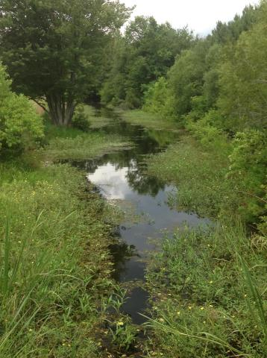
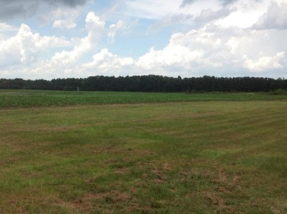
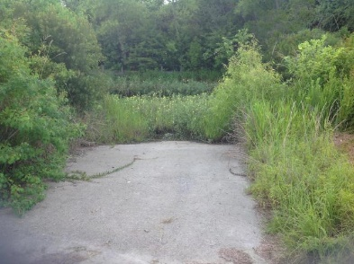
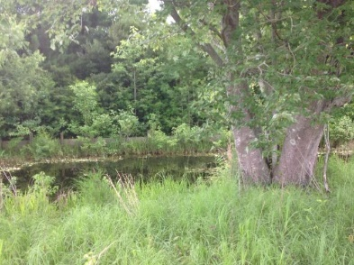
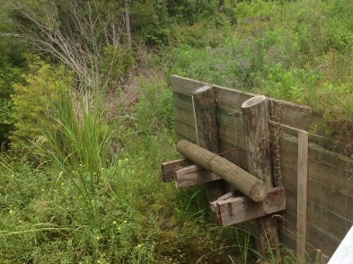

Just Reduced
Buyer can subdivide into 1 acre parcels!
Bring all offers!
0 Campground Road
Eutawville, SC 29048 | MLS# 17017278 | $189,000
This parcel is 5.2 acres. It has water access and own boat ramp. You can see Rocks Pond from the driveway. Buyer may subdivide into one acre parcels. This parcel has potential.
Carla C Davis
Mobile - (843) 437-4873
gaweber@tds.net
AgentOwned Premiere Group
141 A N. Main Street
Summerville, SC 29483

