Slide 1
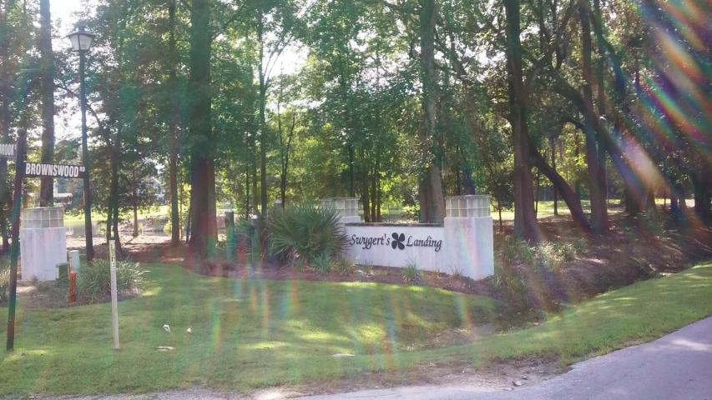
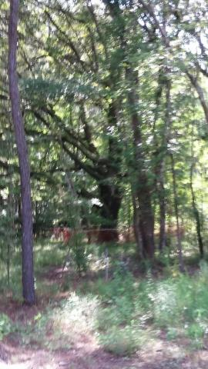
0 Claybrook Street
Swygerts Landing ~ Johns Island ~ MLS# 15023059 ~ $178,200
Close in Deep Water Lot
Great location and perfect lot for a custom build... Very nice trees, with good buffer area. Planned Community with CC&R's in place for your clients protection... Easy ARB submittal process.
Owner will consider one builder for all of the Estate Lots on a takedown to be determined. Lots range from 1.5 acres to 3.22 acres with nine lots currently available. Feel free to call with any questions.
Doug Wells
Mobile - (843) 452-5553
dwells.cds@gmail.com
Harbourtowne Real Estate | 672 Marina Drive, Ste 110 | Daniel Island, SC 29492

