Slide 1
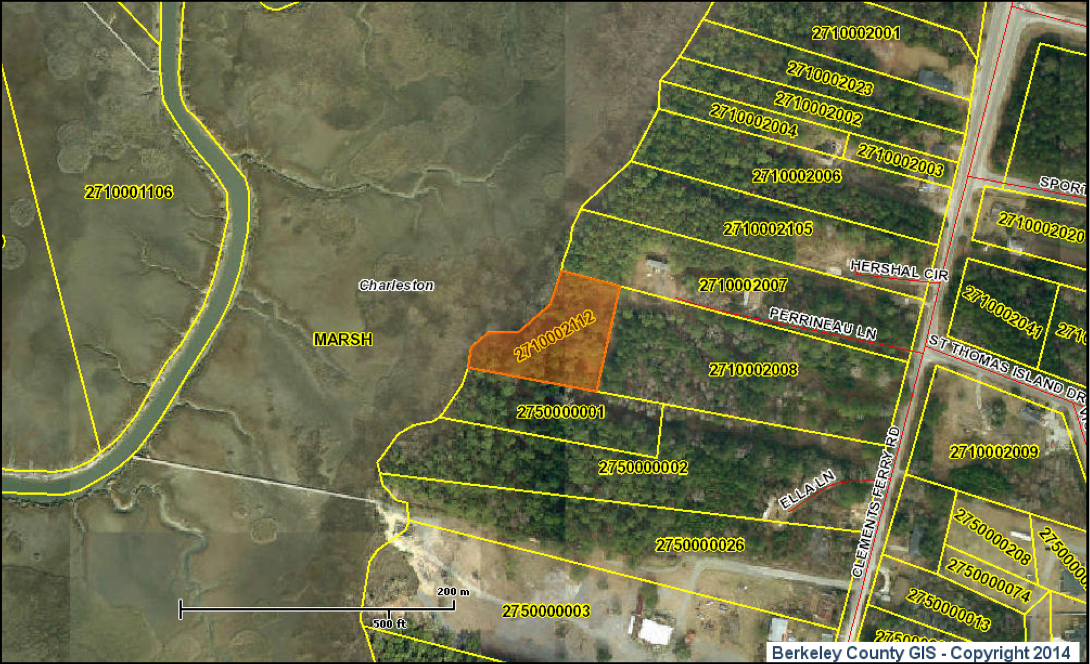
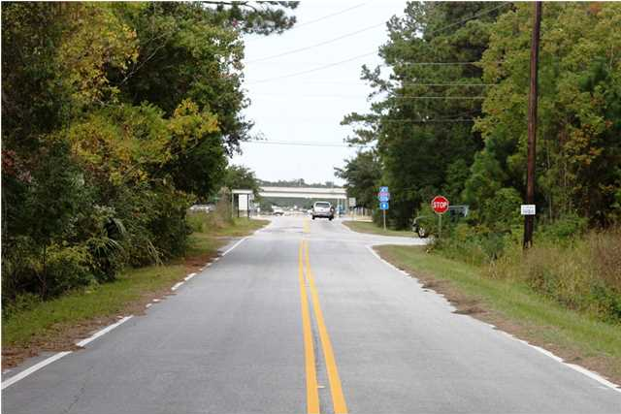
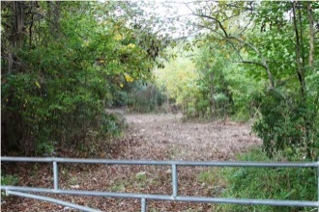
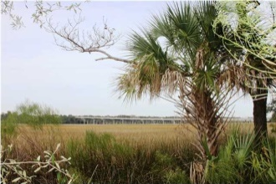
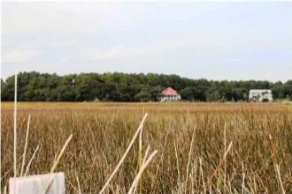
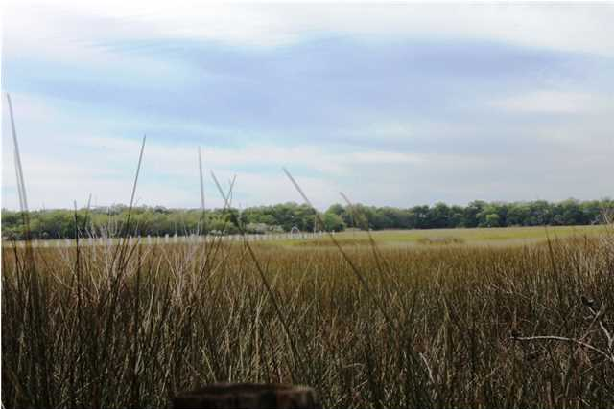

0 Clements Ferry Rd
MLS# 1328208 ~ $199,000
Daniel Island Creek Front with Dock Permit
Dock permit in hand!
Daniel Island living with water access!
This spacious creek /marsh front lot has a newly cleared access easement.
Marshall Walker
843-532-3214 M
mwalker@marshallwalker.com

