Slide 1
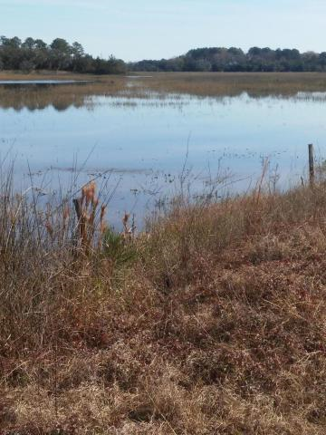
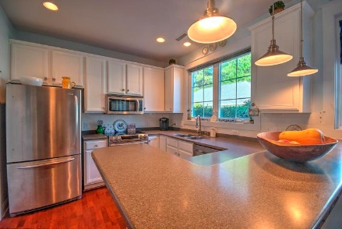
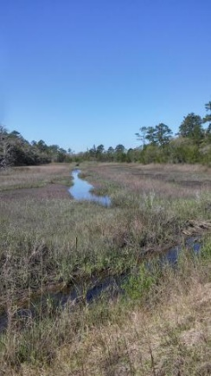
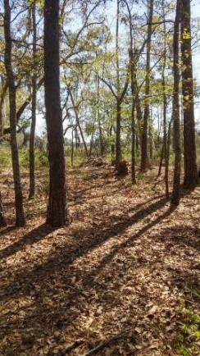
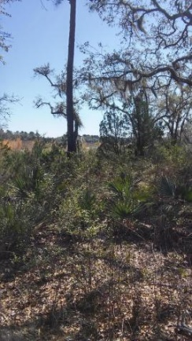
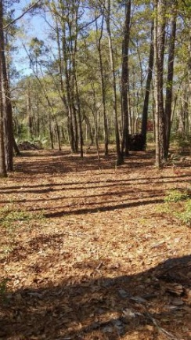
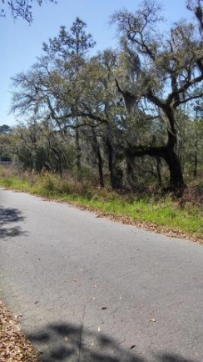
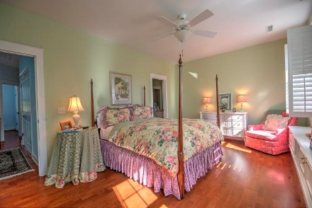


0 Coon Club Road
Meggett, SC 29449
MLS# 16010312 | $105,000
Looking To Build Your Dream Home?
Starbucks card to first 10 agents
LOCATION...LOCATION...LOCATION!!!
If you do not want to live in a subdivision and do not want a HOA, well this might be just what your looking for! Views are incredible and the variety of wildlife is camera worthy. This property is tucked away on a quite paved road right off of Toogoodoo road. This 3 acre property is covered with beautiful oak trees and wild palms. Only minutes away you could be playing a game of golf at Stono Ferry or enjoying a meal at the Harvest Moon restaurant. Enjoy the peace and quiet of country living. Will need septic and well. A must see if you are looking to build your dream home!
Liz Butler
M (843) 367-6604 | O (843) 795-6221
lizbutlerhomes@gmail.com | www.AgentOwned.com
AgentOwned Charleston Group | 902 Savannah Hwy | Charleston, SC 29407

