Slide 1
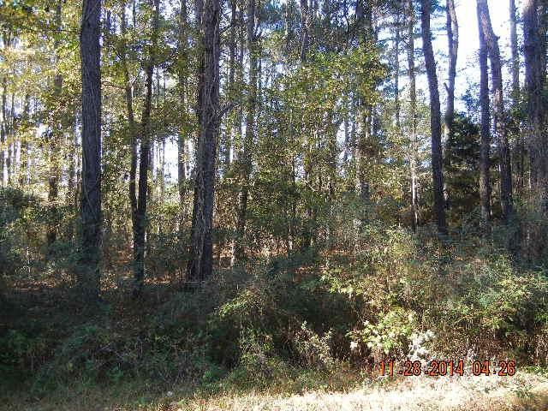
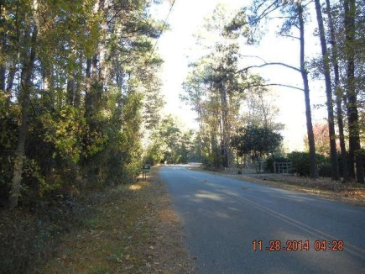
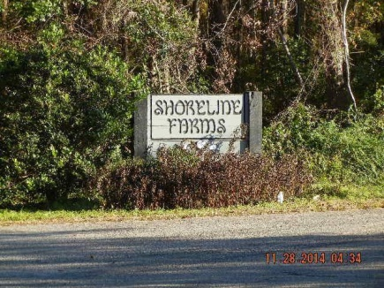
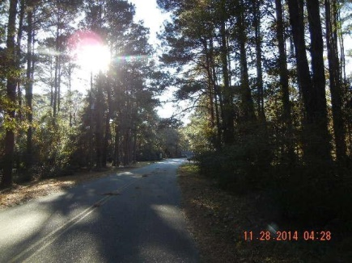


Country living that is close to town!
Best of both worlds!
2.5 acres wooded lot in a great established community! Water and power at the street. This lot has been approved by DHEC for a special septic system. Shoreline Farms community is on deep water of the Stono River with a community dock. Build your dream home today!
0 Coquina Drive ~ Johns Island, SC 29455
MLS# 14030407 | $180,000
Susan Weeks
(843) 813-0495
susanweeksdesign@gmail.com
www.agentownedrealty.com
AgentOwned Charleston Group
902 Savannah Hwy
Charleston, SC 29407-7802

