Slide 1
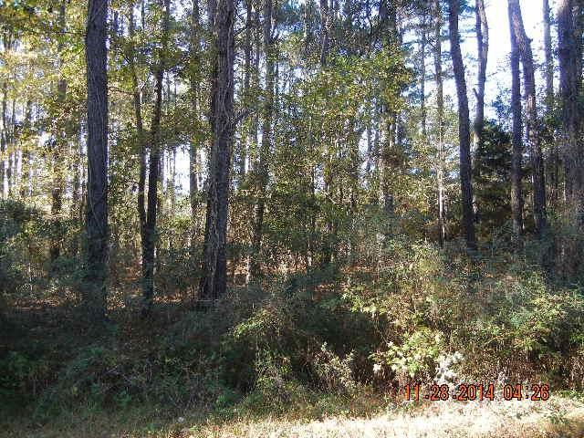
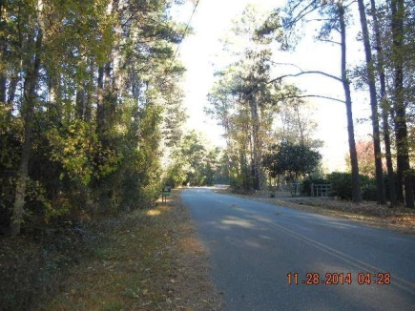
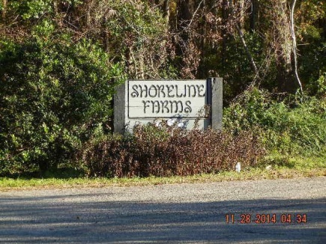
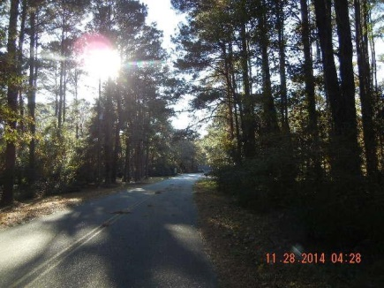


Country living that is close to town!
Best of both worlds!
$2000 Buyer's Agent BONUS!!!
Limited time offer!!
0 Coquina Drive ~ Johns Island, SC 29455
MLS# 14030407 | $172,900
2.5 ACRES WOODED LOT IN A GREAT ESTABLISHED COMMUNITY!
WATER AND POWER AT THE STREET. THIS LOT HAS BEEN APPROVED BY DHEC FOR A SPECIAL SEPTIC SYSTEM.
SHORELINE FARMS COMMUNITY IS ON DEEP WATER OF THE STONO RIVER WITH A COMMUNITY DOCK. BUILD YOUR DREAM HOME TODAY!
Susan Weeks
(843) 813-0495
susanweeksdesign@gmail.com
www.agentownedrealty.com
AgentOwned Charleston Group
902 Savannah Hwy
Charleston, SC 29407-7802

