Slide 1
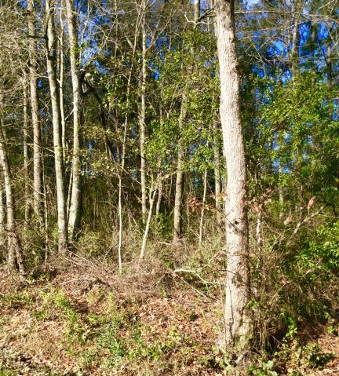
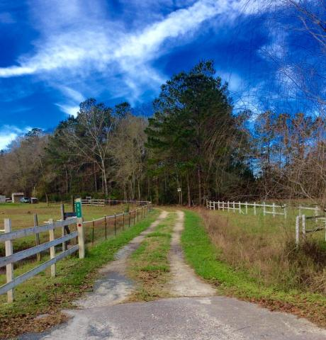
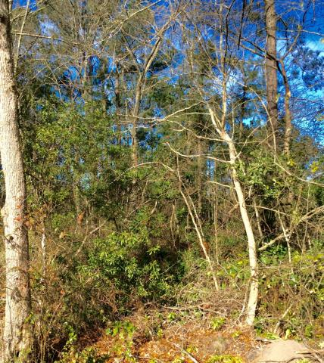
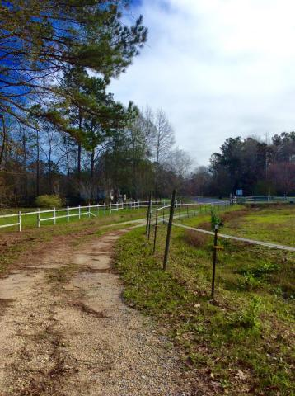
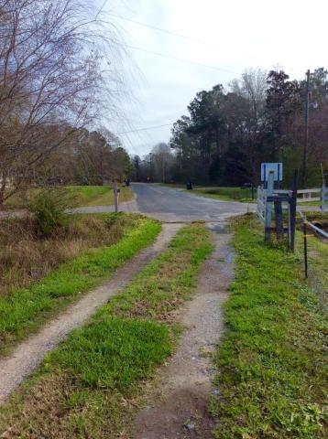

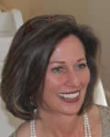
2.6 Acres in Berkeley County! Great place to build your home!
$1,000 Buyer's Agent Bonus
Thru The End Of February
0 Coral Acres Drive ~ Moncks Corner, SC 29461 MLS# 14029031 | $49,000
**WILL ENTERTAIN ALL REASONABLE OFFERS!**
Build your Dream Home on this 2.6 Acre paradise in Berkeley County....Great place to live and work!....lots of nice trees and very private. This lot is in a developed community called Coral Acres.
Very close to Cane Bay School. No restrictions in Coral Acres.... nice area to call home. Perfect for the Home/Business at the same location! Drive out to see this beauty today!
COME SEE THIS GREAT PROPERTY TODAY!
Susan Weeks
(843) 813-0495
susanweeksdesign@gmail.com
www.agentownedrealty.com
AgentOwned Charleston Group
902 Savannah Hwy
Charleston, SC 29407-7802

