Slide 1
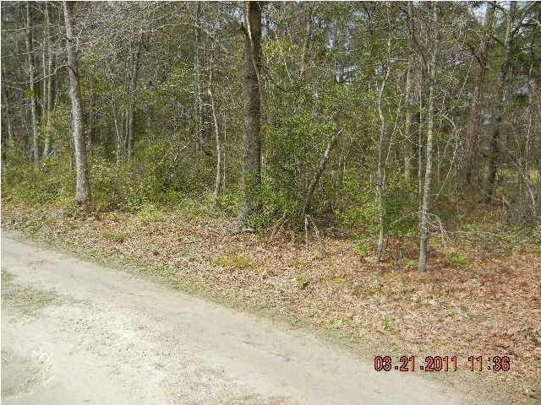

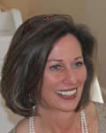
2.6 Acres in Berkeley County! Great place to build your home!
0 Coral Acres Drive ~ Moncks Corner, SC 29461 MLS# 14029031 | $69,000
Lots of nice trees and very private.
This lot is in a developed community called Coral Acres.
No restrictions, nice area to call home.
Perfect for the Home/Business at the same location!
Drive out to see this today!
Susan Weeks
(843) 813-0495
susanweeksdesign@gmail.com
www.agentownedrealty.com
AgentOwned Charleston Group
902 Savannah Hwy
Charleston, SC 29407-7802

