Slide 1
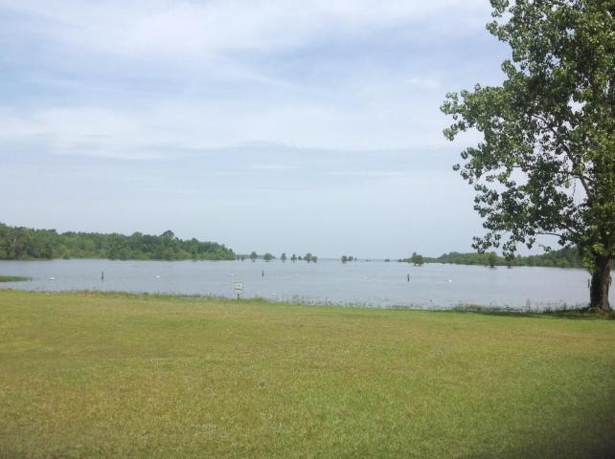
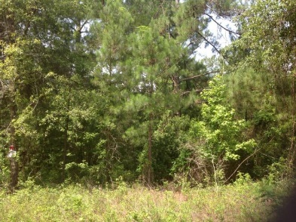
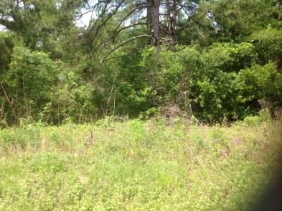
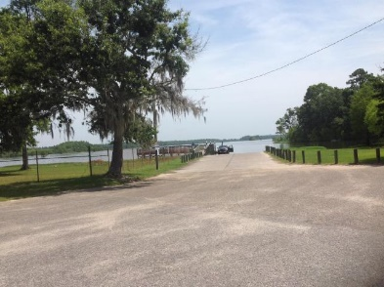
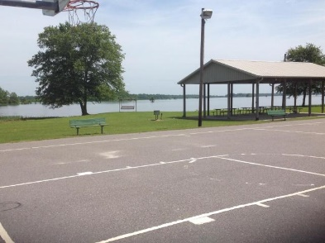

1 Acre Lot Near Waterfront Park In Cross
Just Reduced
0 Dominion Avenue
Cross, SC 29436 | MLS# 17015501 | $16,500
This vacant lot is approximately 5 minutes from public landing with tables and grills. Free boat launch as well as basketball and tennis courts. Also playground for the kids. Perfect for your new home or a weekend getaway at the lake!
Carla C Davis
Mobile - (843) 437-4873
gaweber@tds.net
AgentOwned Premiere Group
141 A N. Main Street
Summerville, SC 29483

