Slide 1
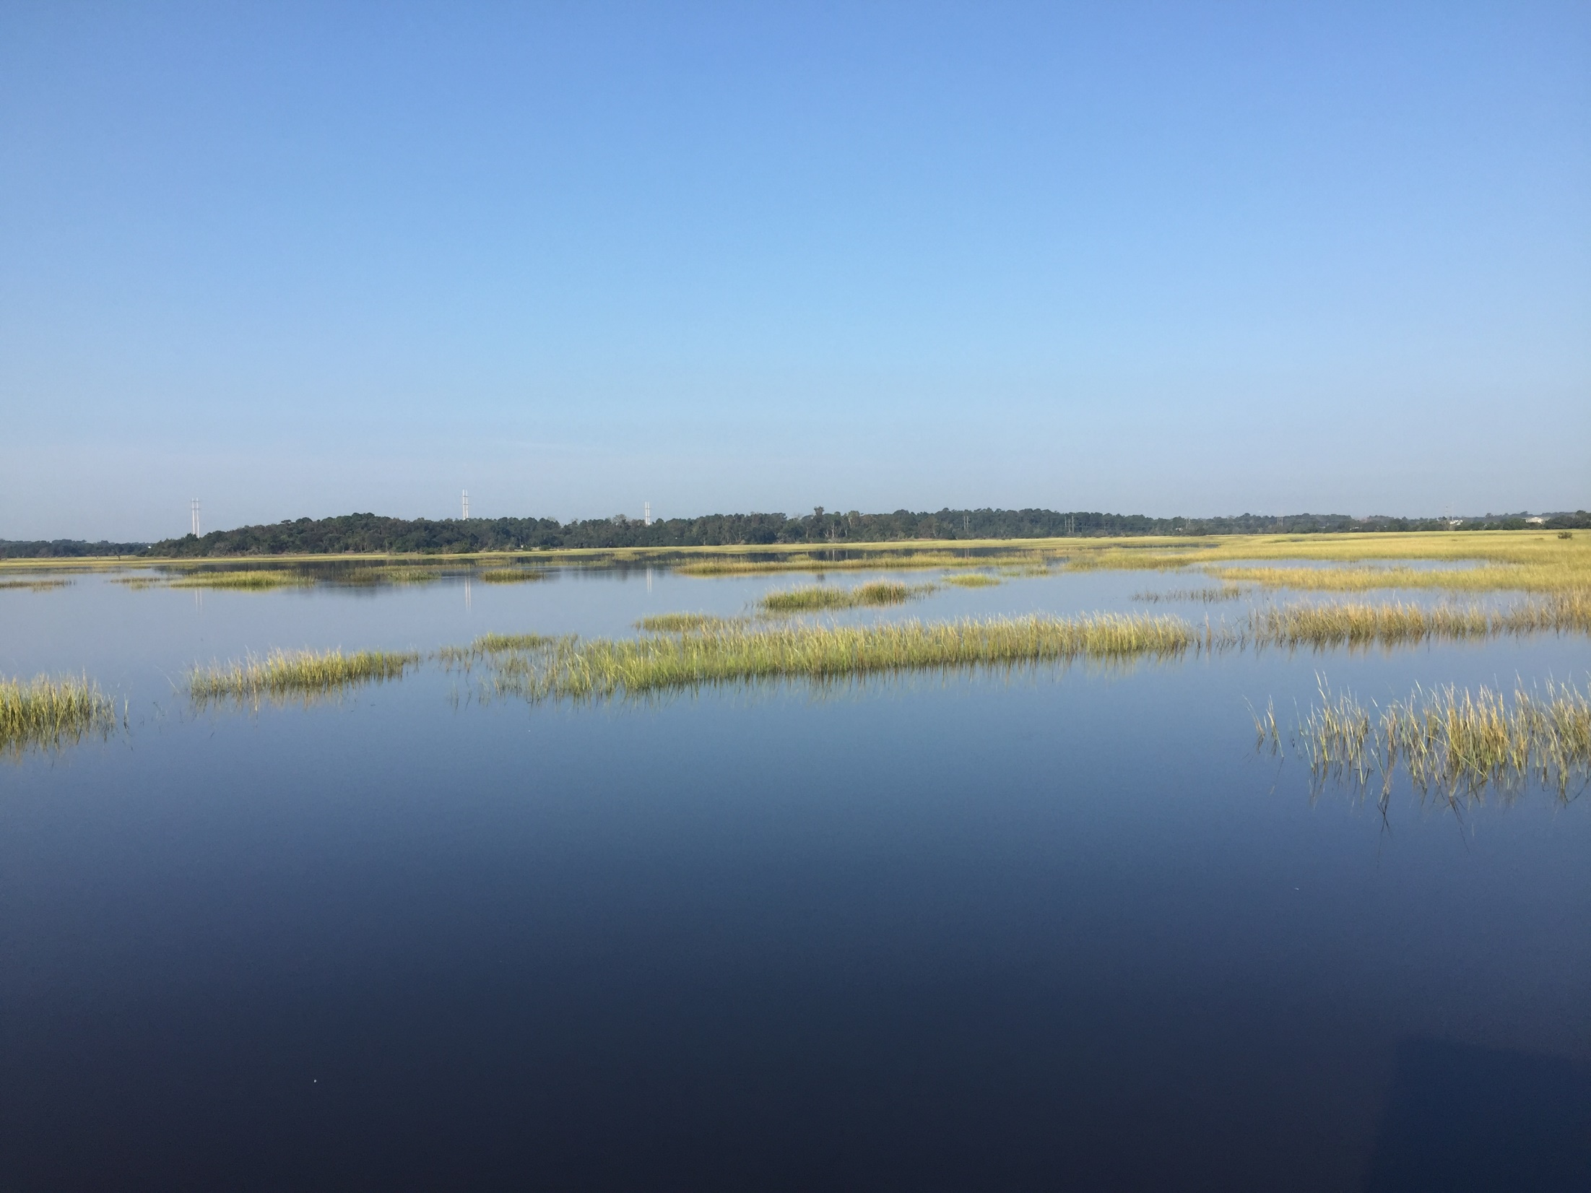
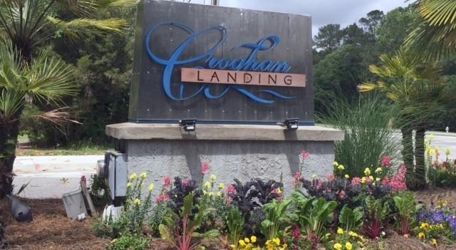
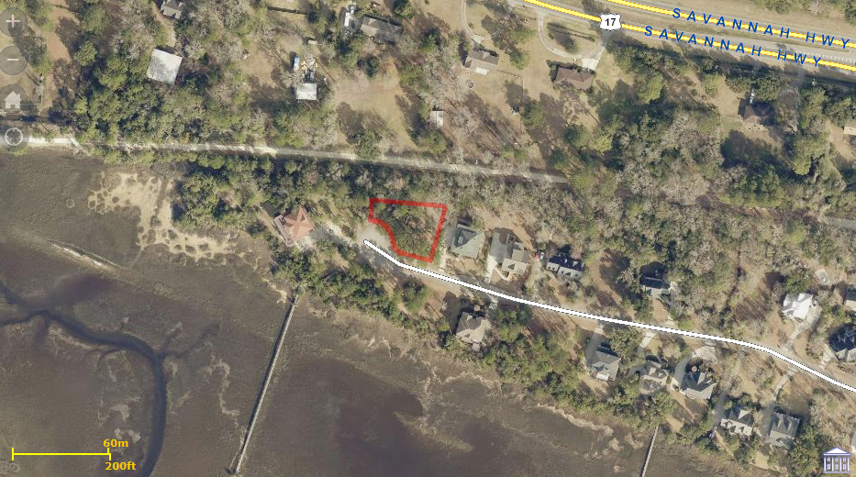
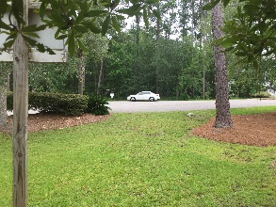
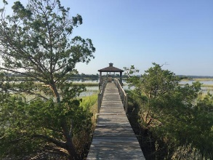
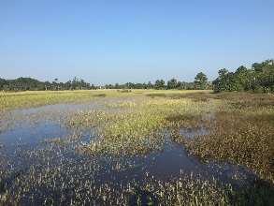
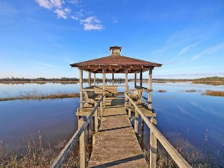
Beautiful Home in Paddock Point
0 Egret Lane
Croghan Landing
Charleston, SC 29414
MLS# 17012118
$185,000
Back on the Market!
Motivated Seller! 3.5% Commission!
Bring your offers!!
!!! Back on Market!!! If you are looking for a homesite with a marsh view this is the one for you. This beautiful homesite is on a culdesac in the sought after Croghan Landing Community. When you build your home on this large homesite you will have some fantastic views of the Stono River with all it's natural beauty. There is a Community dock that is just steps from the property and leads to the Stono River. In the back of the beautiful large homesite, you will find the Charleston County Green Way that goes for miles for you walking, jogging or biking pleasure. There is a common area in front of this homesite which is owned by the h.o.a. This would also be a very profitable lot for a builder to do a custom or even a spec home. !! Seller is Motivated !!
Bruce Miller
charlestownehomes@comcast.net | (843) 813-4591 | www.charlestonlifestyle.com
Brand Name Real Estate | 4 Carriage Lane, Suite 106 | Charleston, SC 29407

