Slide 1
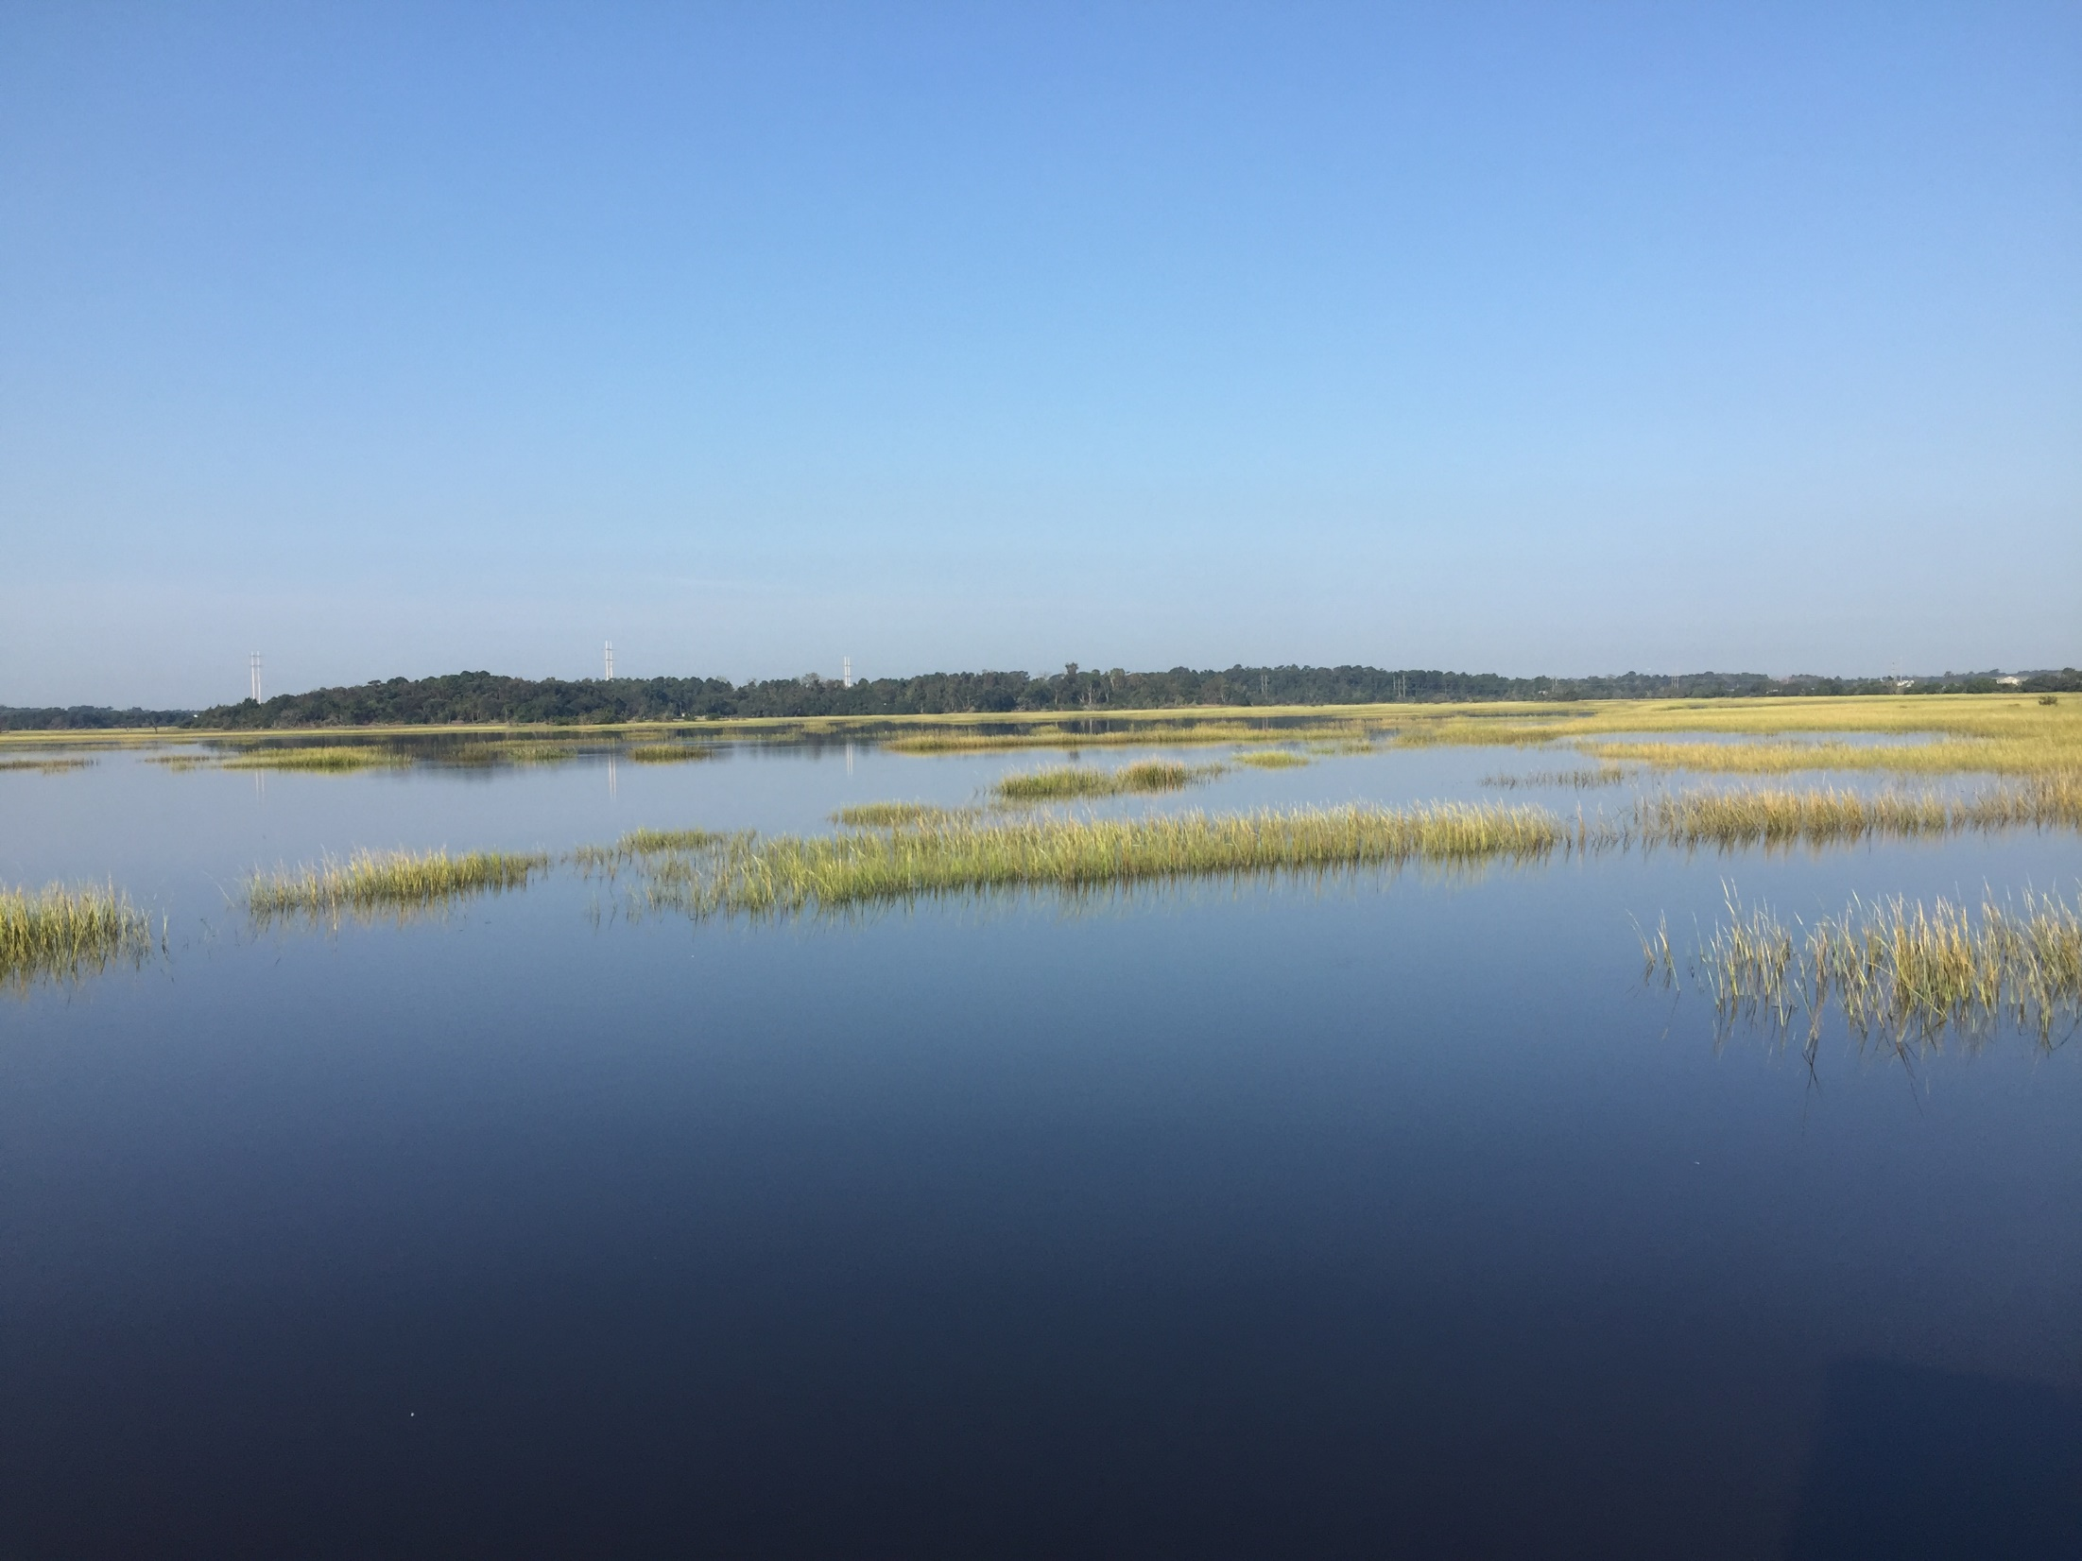
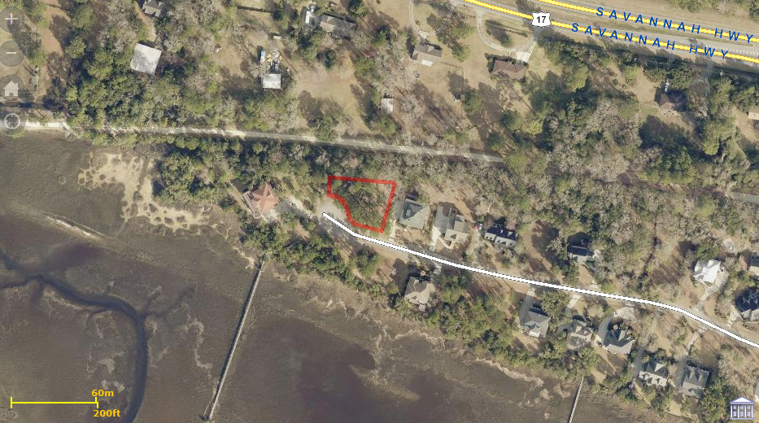
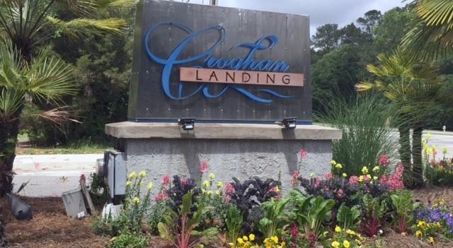
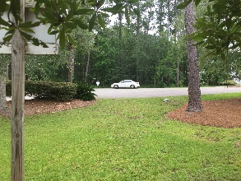

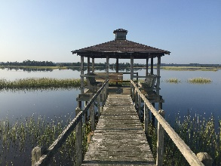
Beautiful Home in Paddock Point
0 Egret Lane
Croghan Landing
Charleston, SC 29414
MLS# 17012118
$199,000
Recently Reduced!
If you are looking for a homesite with a marsh view this is the one for you. This beautiful homesite is on a cul-de-sac in the sought after Croghan Landing Community. When you build your home here you will have an unrestricted view of the Stono River with all it's natural beauty. There is a Community dock that is just steps from the property and leads to the Stono River. In the back of the beautiful large homesite, you will find the Charleston County Green Way that goes for miles for you walking, jogging or biking pleasure. There is a common area in front of this homesite which is owned by the HOA
Bruce Miller
charlestownehomes@comcast.net | (843) 813-4591 | www.charlestonlifestyle.com
Brand Name Real Estate | 4 Carriage Lane, Suite 106 | Charleston, SC 29407

