Slide 1
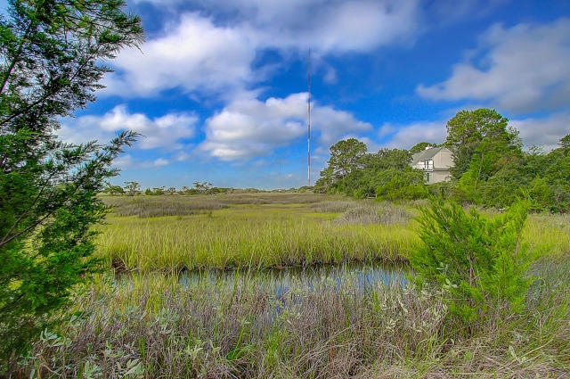
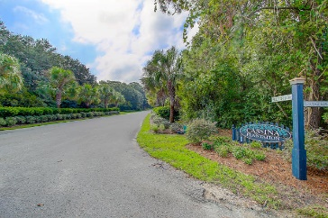
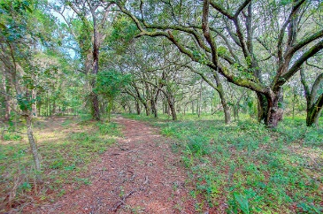
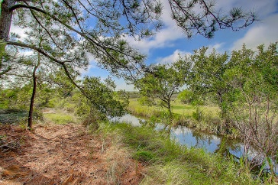
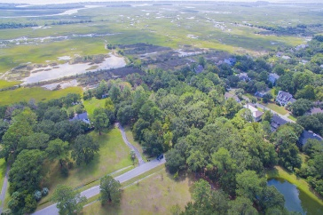


0 Harwick Road
Cassina Plantation
Mount Pleasant, SC 29464
MLS# 16024391
$925,000
3 Acres in Cassina Plantation
Spectacular Views of the
Marsh & Intracoastal Waterway
Love a Spectacular View? Incredibly private 3 acres of land in the heart of Mt. Pleasant. These 3 acres feature an established canopy of live oaks that overlook the marsh and Intracoastal waterway. Very desirable property and perfect to build your desired dream home in this secluded neighborhood of Mt. Pleasant with fabulous views but remain close to shopping, beaches and schools.
Darlene Smith
Office - (843) 886-8110
Mobile - (843) 696-7824
darlenesmith@carolinaone.com
DarleneSmithTeam.com
Carolina One Real Estate
1503 Palm Blvd Ste
Isle of Palms, SC 29451

