Slide 1
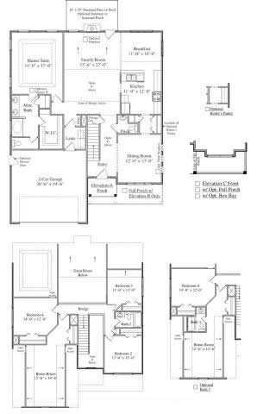
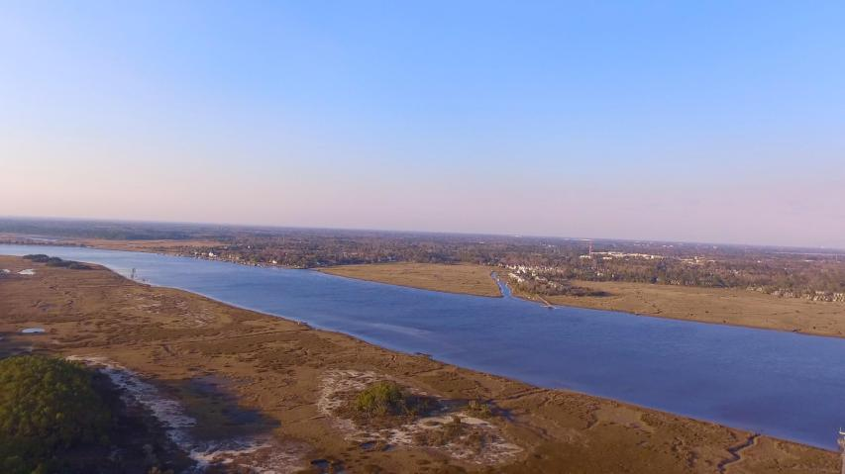
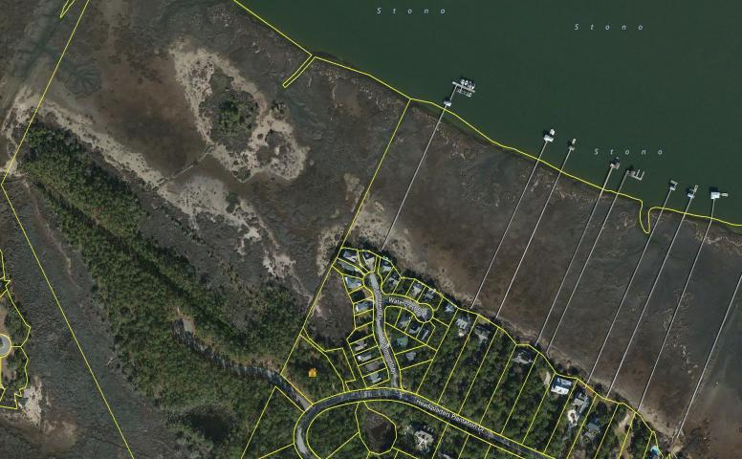
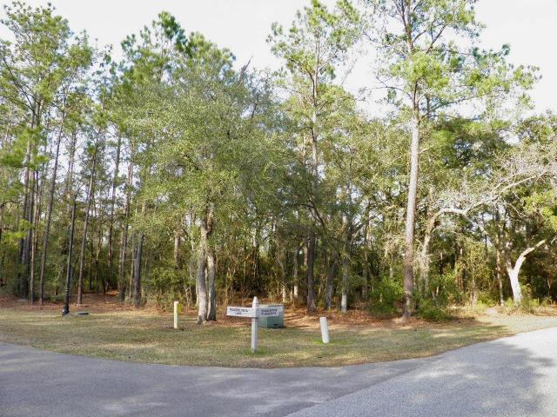


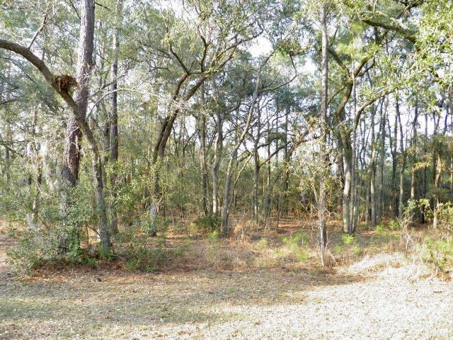
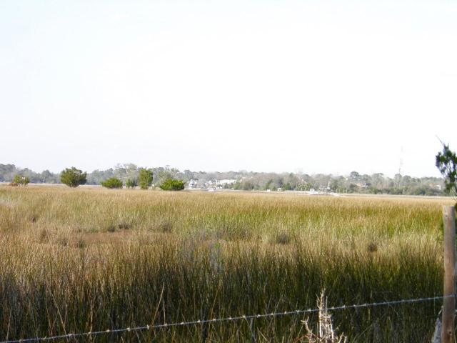

0 Headquarters Plantation Drive
Headquarters Plantation ~ Johns Island ~ MLS# 17002936 ~ $399,000
This is it! Gorgeous lot over 1 acre with incredible views located in convenient and highly desirable Headquarters Plantation. Build your dream home and position it to take advantage of the spectacular marsh and direct water views of the Intracoastal Waterway along the Stono River. Gated Headquarters Plantation is located just over the Stono Bridge connecting James Island and Johns Island. It boasts a quick commute to downtown and is in close proximity to many amenities including an adjacent marina and pool club, golf course, great restaurants, and shopping. You're sure to love the tranquility of the island with its natural beauty and abundant wildlife. Imagine evenings on your backporch entertaining family and friends as you watch the boats on the Intracoastal, the bald eagles, the heron and egrets fly through the marshes. One of the greatest features of living in Headquarters Plantation is the 'away from it all' feel while still being approximately 12 minutes from downtown.

