Slide 1
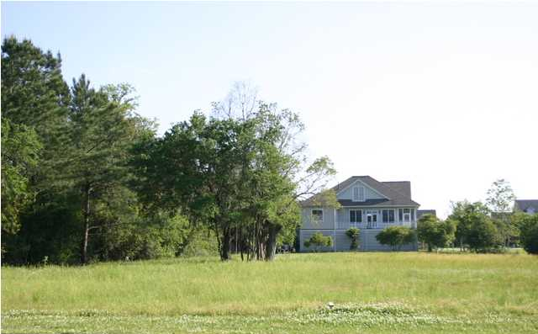
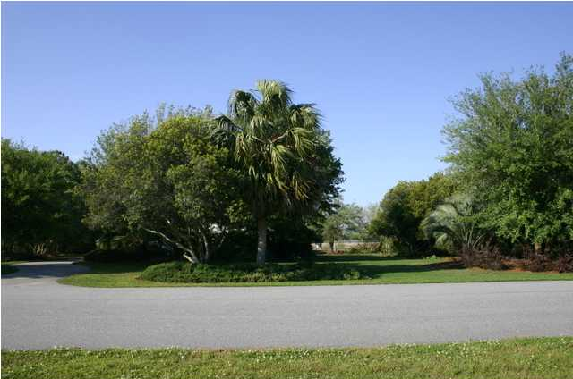
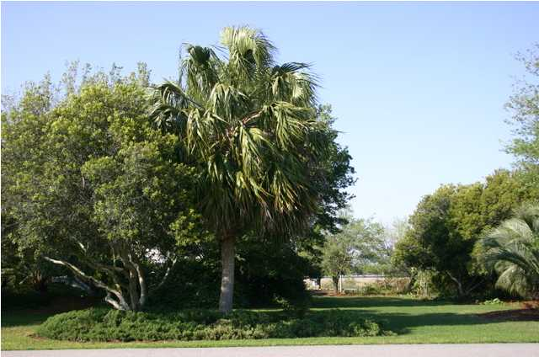


Headquarters Island 0 Headquarters Plantation Dr, Johns Island
MLS# 1301706 - $222,500
Wonderful lot and over half an acre! Located in the gated community of Headquarters Island that sits beside the Stono River. This lot is across the street from the Intracoastal Waterway with beautiful marsh and river views. The homes and lots across the street are on deep water with existing docks in place. Build your home to take advantage of the incredible views! Headquarters Island is 10 minutes from downtown. The new St Johns Marina with available boat slips and optional membership to their pool is just around the corner from the entrance to Headquarters Island - a golf cart ride! Shopping and many great restaurants are close by as well as the Municipal Golf Course. Headquarters Island has been hot! Don't miss out on this opportunity to build in a great neighborhood - away from it all, but so close!

