Slide 1
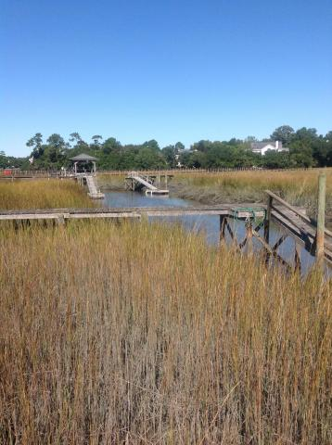
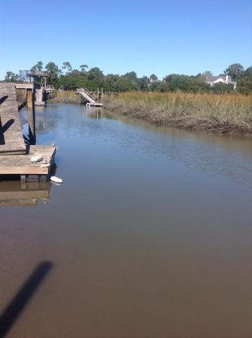
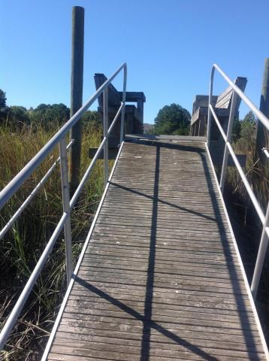


Just Reduced!
Build Your Dream Home
on the water close in Mt Pleasant 29464
0 Hidden Boulevard
Hidden Cove ~ Mount Pleasant ~ MLS# 15031487 ~ $389,000
Tidal Creek with dock in place.
Hidden Cove is an established neighborhood with pool and tennis court.
Minimum build 1800 sq feet.
Chuck & Edy Mimms
Cell 843-224-9507
Office 843-530-8100 www.sanddollarsc.com
www.facebook.com/Sanddollarsc
Sand Dollar Real Estate Group | 2205 Middle Street | Suite 203, Mailbox 2 | Sullivans Island, SC 29482

