Slide 1
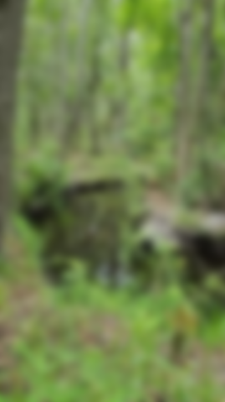
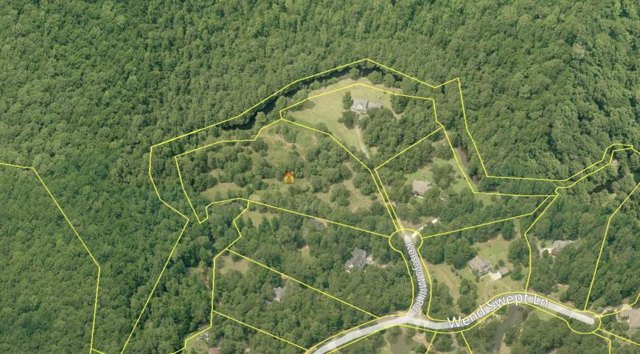
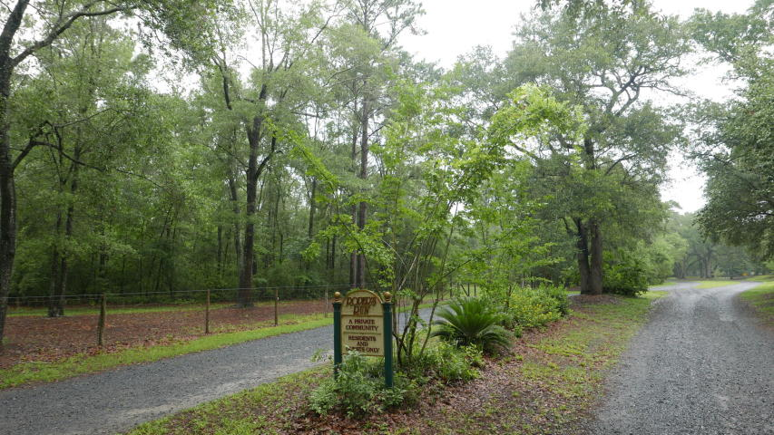
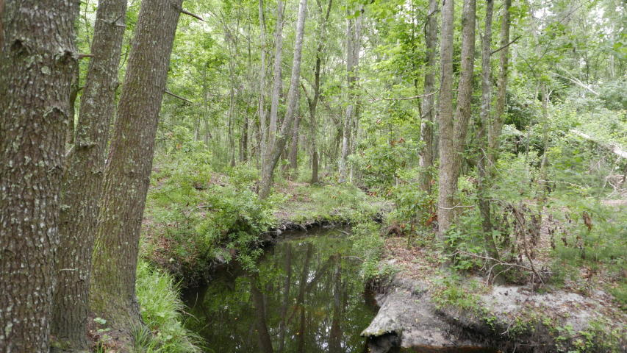
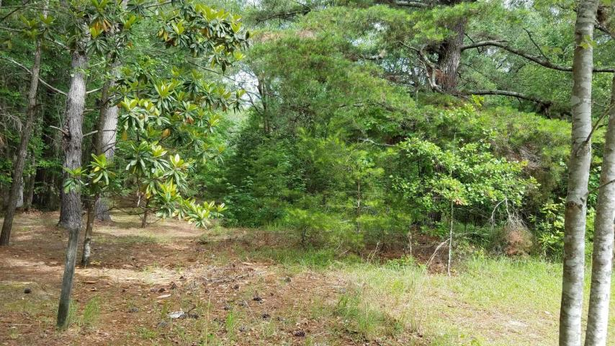


0 Kelseys Mill Road
Ropers Run ~ Ravenel, SC 29470 ~ MLS# 17014474 ~ $150,000
Don't miss this opportunity to get the last buildable lot in the upscale well-maintained Roper Run neighborhood. This beautifully wooded lot feels incredibly private but still enjoys the security of being part of an established community. Build your dream home and enjoy the tranquil natural setting away from the hustle and bustle. Peaceful living!!! With stately grand oaks and a small creek this property must be seen to be appreciated. There are equestrian trails throughout the neighborhood. Only 13 miles from hwy-526 and 17 miles from downtown. Enjoy the wildlife and the easy drive to town.
David Andrews
(843) 452-0113
charlestonda@gmail.com
AgentOwned Charleston Group • 902 Savannah Hwy. • Charleston, SC 29407
Real Estate • Mortgage • Insurance

