Slide 1
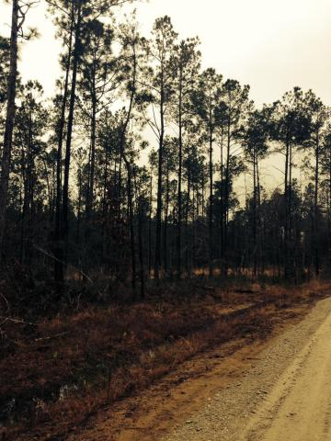
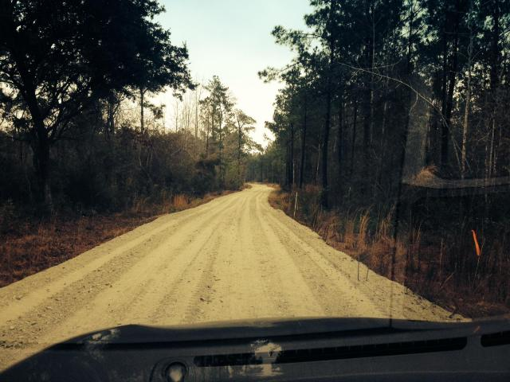
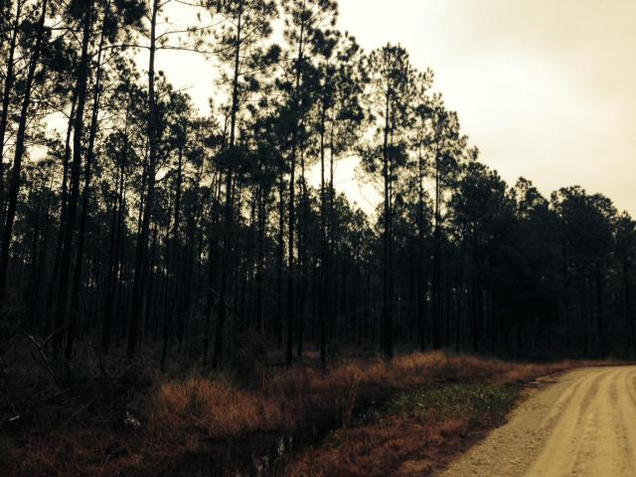
0 Landry Farms Way
McClellanville
MLS# 15001475
$669,000
130 Acres of Vacant Land
Approximately 130 acres total (5 lots). This land is perfect for horses, hunting, biking, four wheeling, & logging roads are in! The lots & TMS# included in this listing are Lot 10 Landry Farms Way / TMS#762-00-00-174 (Approx 21.22 acres), Tract 5 River Rd/ TMS#762-00-00-080 (Approx 7.30 acres), Tract 6 River Rd/ TMS#762-00-00-096 (Approx 25.80 acres), River Rd / TMS#762-00-00-073 (Approx 48.38 acres), & Tract 8 River Rd / TMS#762-00-00-098 (Approx 27.70 acres). This would be a great candidate for a conservation easement. It would save the Buyer thousands in tax savings depending on the tax bracket.
Charles Salmonsen
M (843) 224-0300 | O (843) 388-6613 | charles@salmonsen.com
Salmonsen Realty | 864 Lowcountry Blvd Ste B | Mt Pleasant, SC 29464

