Slide 1
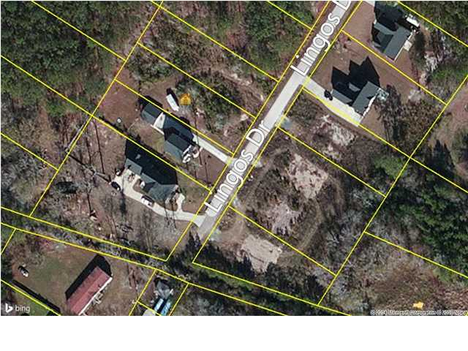
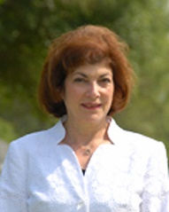

Great location! Build the home of your dreams!
0 Lingos Rd
Pine Hill Acres - Summerville
MLS# 1408362 & 1408392
$20,000 - 0.34 Acres (ea.)
Owner has two lots listed and will sell either one or both together… Bring all offers!!
Catherine Marshall
843-991-1898
cathymarshall@carolinaone.com

