Slide 1
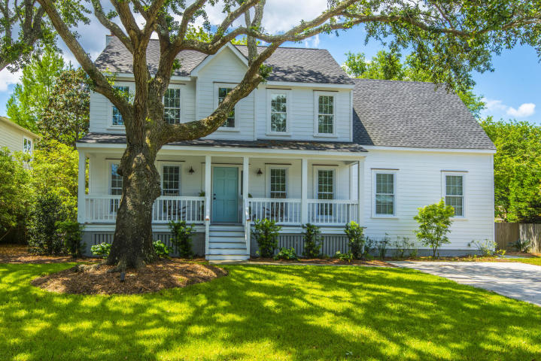
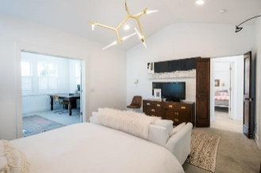
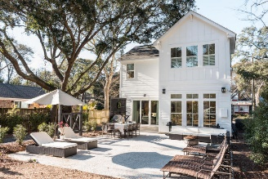
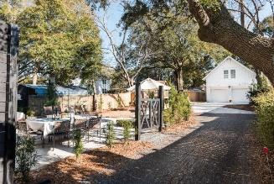
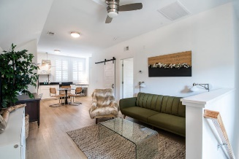
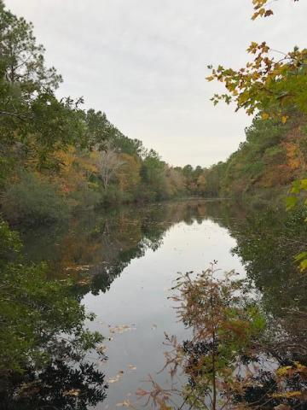


0 Lofton Road St James Santee Parish ~ McClellanville ~ MLS# 18020426 ~ $325,000
Price Reduced To $1,075,000!
Plus Sellers Offering A $25,000
Allowance To Buyer
W/ Acceptable Offer!
Open House March 3, 1-3pm
1509 Old Village Drive Old Village Landing ~ Mt Pleasant ~ MLS# 18028947 ~ $849,000
New updates, new vanities and more. Stellar renovation of an "easy living" home, steps away from one of the top schools in the state and in a quaint, quiet and friendly neighborhood close to downtown and the beaches! Close to the Old Bridge and the trendy Old Village shops and restaurants. First level has an open flowing design, a separate office, another dining area and an adjoining large master suite. There are four generous sized bedrooms and two full baths upstairs. You will love the wonderful outdoor spaces - large screened porch off of the family room, fire pit for chilly nights and a shady brick patio for relaxing or perfect for a party!
Price Reduced
Beautiful tract of land for you to build your dream house on!! Property has large mature trees and a very nice two acre pond for fishing and viewing! Located on a wide peaceful dirt road, you are only 19 miles from Mt Pleasant and 4.3 miles to McClellanville. This land is protected by a conservation easement which allows timber harvesting and one SF home and a guest house (total 6,000 sf).
Mac Jenkinson
M (843) 224-0210
mac@carolinaone.com
Beth Moore
M (843) 532-4892
bmoore@carolinaone.com
www.jenkinsonandmoore.com
Jenkinson & Moore, LLC | Carolina One Real Estate | 1503 Palm Blvd | Isle of Palms, SC 29451-2280

