Slide 1
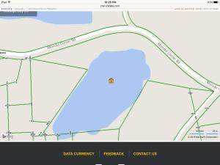
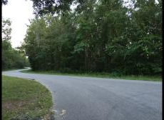
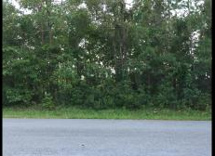

Over 10 acres of land in Eutawville!
0 Moncks Corner Road
Eutawville, SC 29048 ~ MLS# 16023686 ~ $69,900
PROPERTY HAS A POND FOR FISHING.
PROPERTY IS PRIVATE YET ABOUT ONE MILE TO HWY 6.
ALSO MINUTES TO BIG CATHEAD FOR PUBLIC BOAT ACCESS.
BUYER TO VERIFY ALL INFORMATION OF IMPORTANCE.
Carla C Davis
Mobile - (843) 437-4873
gaweber@tds.net
AgentOwned Premiere Group
141 A N. Main Street
Summerville, SC 29483

