Slide 1
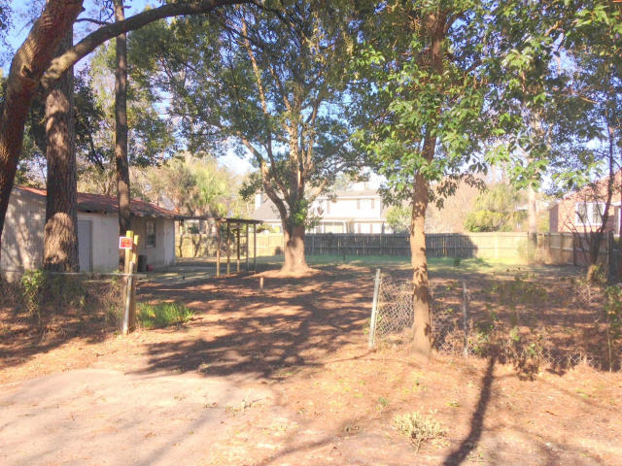
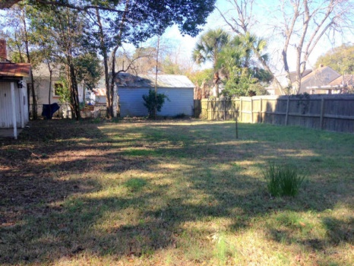
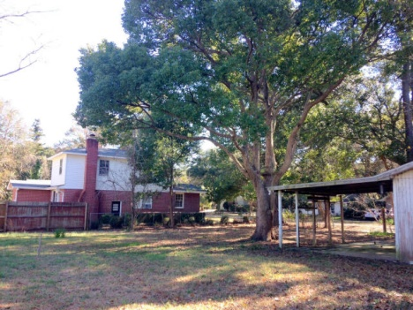

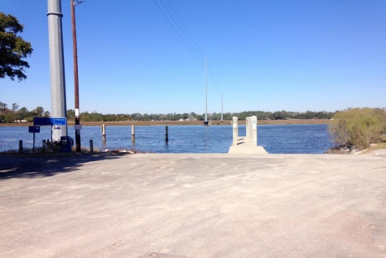
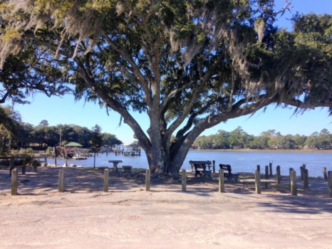


Riverland Terrace Buildable Lot!!!
0 Parkway Drive
Riverland Terrace
Charleston
MLS# 15002404 - $169,000
One of the last buildable lots in Riverland Terrace--build your custom dream house! This section of the Terrace is extremely quiet and only a block from the boat landing and the public park on the Wappoo Cut. Great Oak trees at the very front of the lot. Just a couple walkable blocks to the Terrace movie theater and great restaurants. If you have had a hard time finding your dream house in the current market then come build it!
Dan Lorentz, Realtor
ERA Agent of the Year
843-532-4653
dan@danlorentz.com
www.danlorentz.com
ERA Wilder Realty, 125-F Wappoo Creek Dr, Charleston, SC 29412

