Slide 1
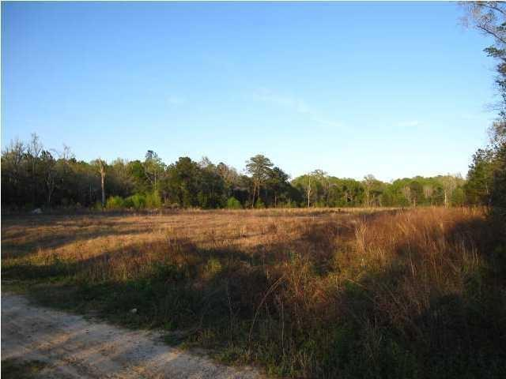

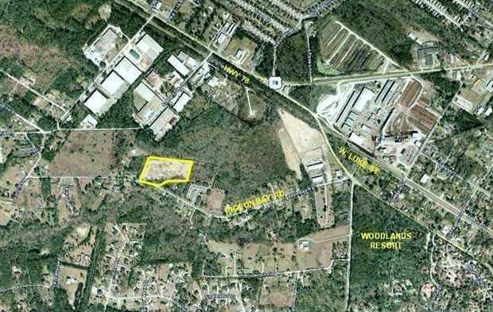



Approved 72 unit apartment complex! Come build your cash flow!
0 Pidgeon Bay
Summerville, SC 29483
MLS# 14031662
$547,500
Fully designed, engineered and permitted multifamily site. Plans include 72 apartment units and a 1492 sq. ft. club house. The complex is planned to have 9 one bedroom @ 716 sq.ft. each, 48 two Bedrooms @ 958 sq.ft each, and 16 three Bedrooms with 1073 square feet each.
Located in a X Flood Zone. R-4 zoning! This is only than $7500 a door!!! Located miles from downtown Summerville, minutes from shopping & restaurants. Build them, they will RENT!.
Nearby complex has 48 units that is currently 100% occupied! Seller says the necessary sewer taps are available.
Seller is MOTIVATED! Bring your offer today! Surveys, plans, etc are located in the documents section.
Lizzie H Ray
(843) 452-9298
lizzieray1122@gmail.com
Eric Draper
(843) 442-7118
eric.draper@gmail.com
www.charlestonrealestategroup.com
Charleston Real Estate Partners. LLC | 792 Folly Rd. C1 | Charleston, SC 29412

