Slide 1

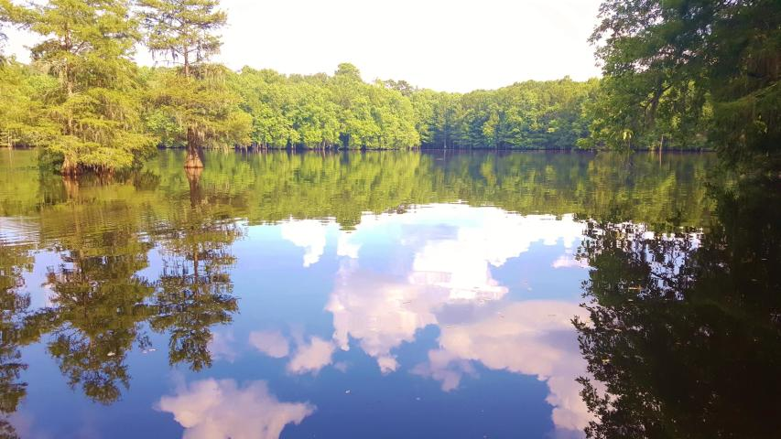
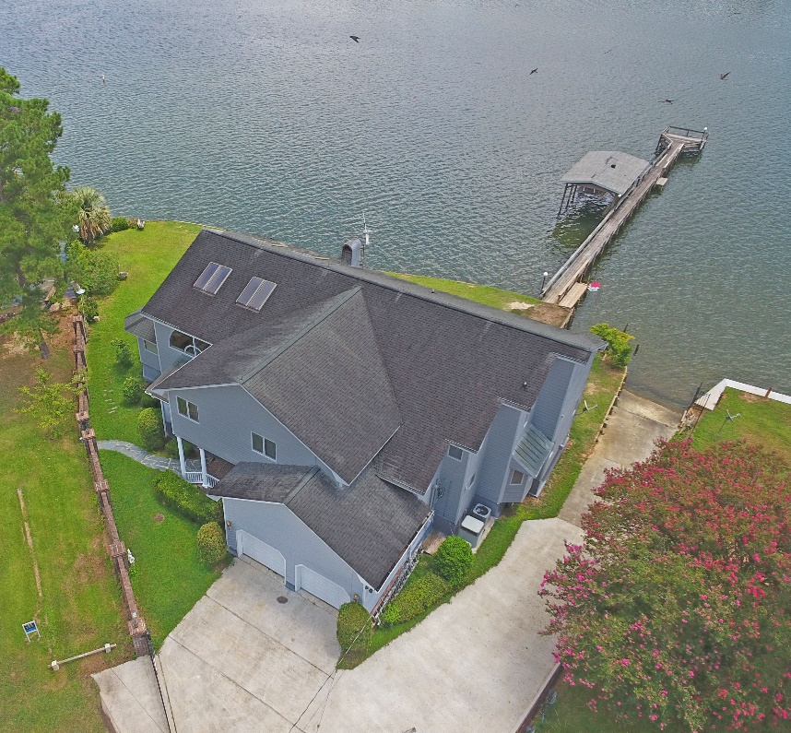
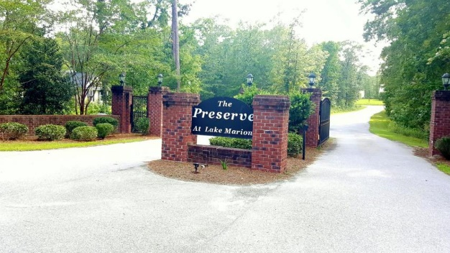
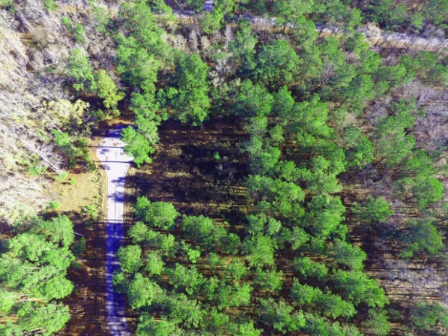
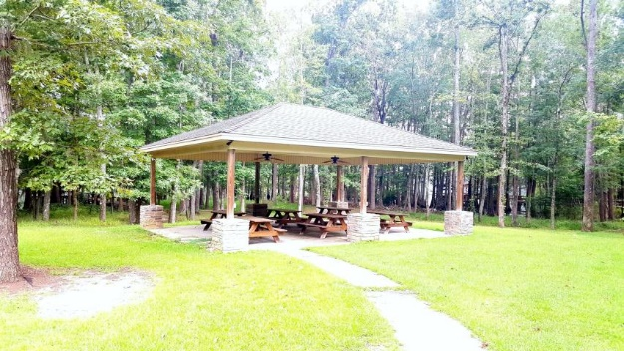

Developers Wanted!
The Preserve | Elloree, SC 29047
MLS# 17022681 | $495,000
24 Lots on Lake Marion in Elloree SC
Only 1 hour drive to Charleston / Summerville
Gated Community with existing Boat ramp, Dock,
Picnic areas and Paved roads
Large buildable lots
Be part of the next housing need here at the Lake
Lake Homes Realty, LLC
Elloree, SC 29047
www.SCLakeLife.com
Kristie Anderson
(803) 387-9459
kristie@sclakelife.com
Lake Homes Realty, LLC
Susan Stroman
(803) 505-2674
thestromanteam@gmail.com
Premier Properties of the Carolinas

