Slide 1

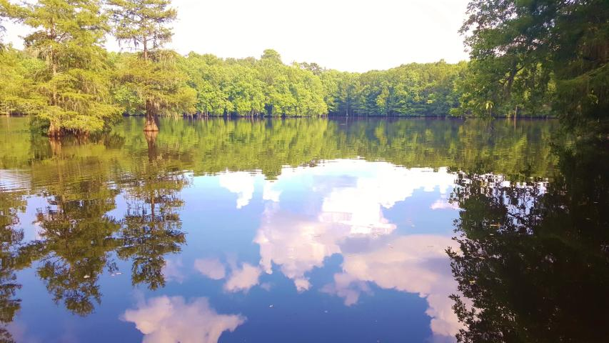
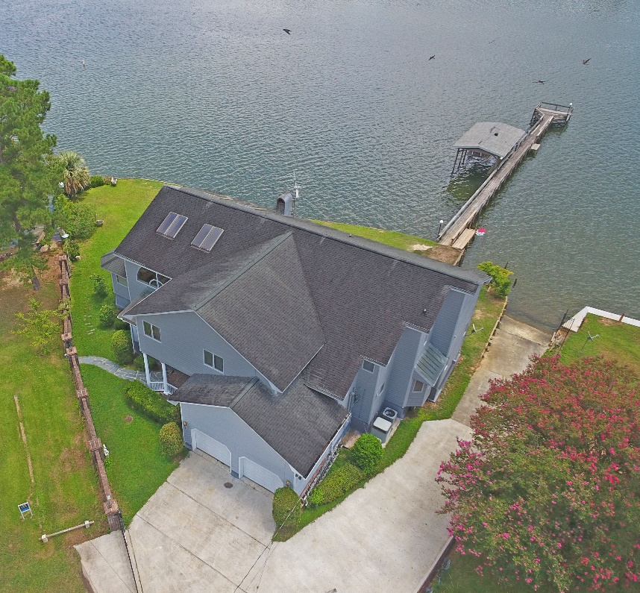
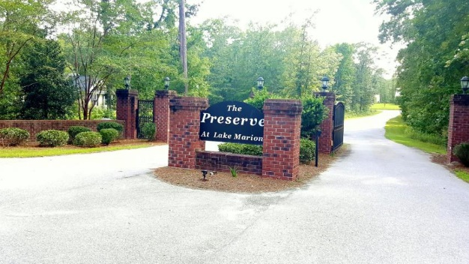
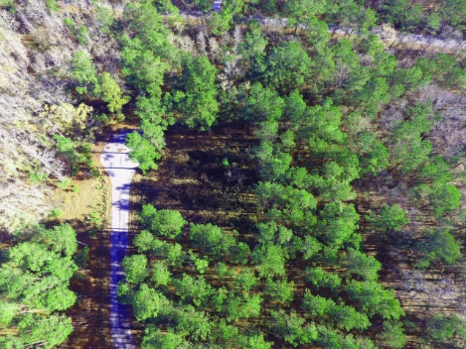
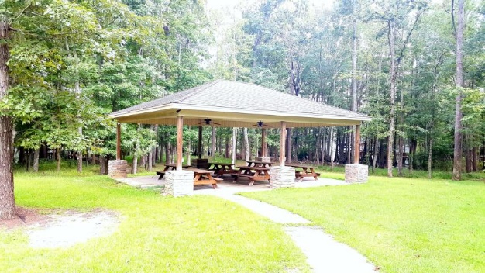

Builders / Investors
The Preserve | Elloree, SC 29047
MLS# 17022681 | $495,000
Looking for the next Hot Spot to Invest?
Planned 24 Large Lots in a Gated Area on
Lake Marion with in place dock, boat ramp,
Picnic area. Only 40 mins from Volvo and just 5
Miles from I95 and only 15 mins from I26.
Calhoun county water available.
Lake Homes Realty, LLC
Elloree, SC 29047
www.SCLakeLife.com
Kristie Anderson
(803) 387-9459
kristie@sclakelife.com
Lake Homes Realty, LLC
Susan Stroman
(803) 505-2674
thestromanteam@gmail.com
Premier Properties of the Carolinas

