Slide 1
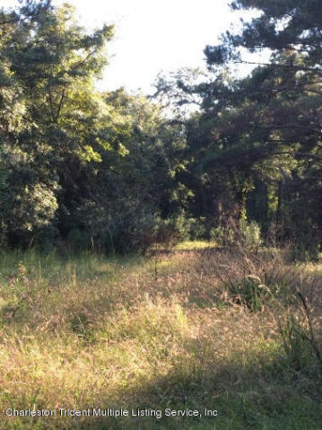
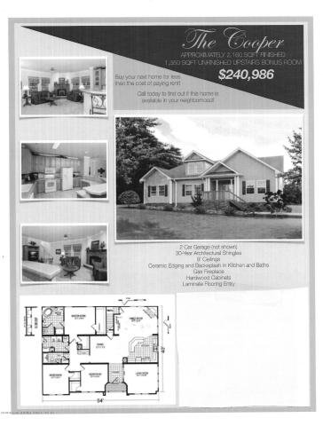

0 Providence Circle
Covenant Preserve
Awendaw, SC 29429
MLS# 14027131
$404,486
Better Than New!
Price includes the Lot & the Proposed Construction Home!
Lot 3 is set on a small pond in a Natural Setting. It is one of 8 lots in the community. You can purchase the land sold separately under MLS# 1426636 and have your choice to build the attached, proposed construction plan or choose from other floor plans available. You can also opt to use your own builder. This is your chance to own a Brand New Home in a serene setting yet close to everything Mt. Pleasant has to offer! This will NOT be a cookie cutter community. There is NO HOA FEE! There are plans for 2 county parks to be within 1 mile. One of which will provide a community, Deep Water Dock!
Donna Andreano
843-256-3348
donnaa@agentownedrealty.com
www.yourhomeincharleston.com
AgentOwned Preferred Group | 824 Johnnie Dodds Blvd | Mt Pleasant, SC 29464

