Slide 1
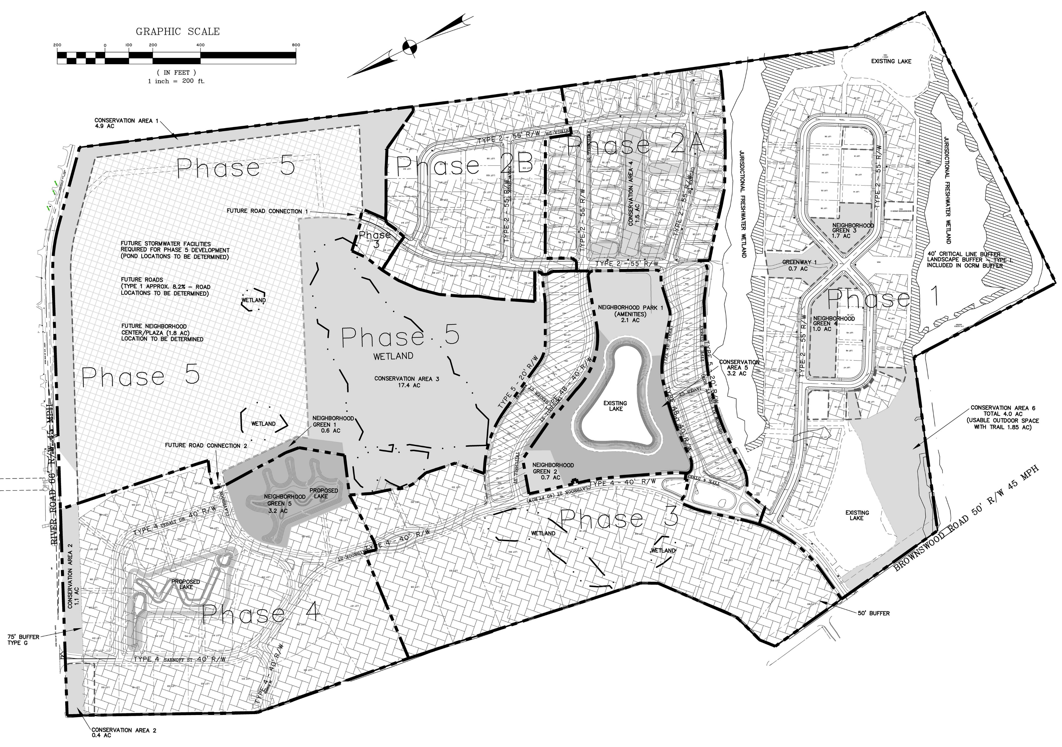
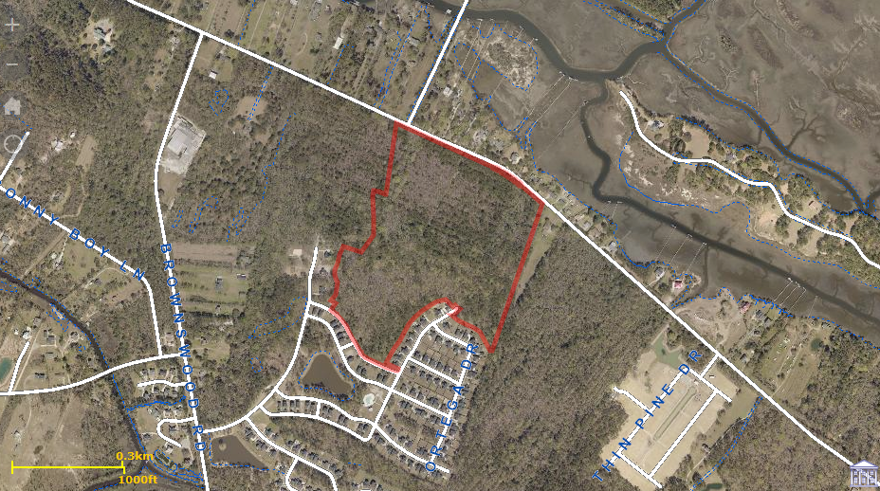
GREAT INVESTMENT OPPORTUNITY! STEADY INCOME.
Ideal Location for Mixed Use and Senior Living Campus
0 River Road
Swygert's Landing
Johns Island
MLS# 16028405
$4,500,000
Bring your Mix Use and or Senior Living Developers to this premier location
Reduced $200,000... Motivated Seller... Price based on 31 + or - high acres zoned ''Mix Use'' and approved for commercial use including retail/office and a For Profit ''Senior Living Campus''... NO SINGLE FAMILY OR MULTI FAMILY FOR SALE OR RENT UNITS ALLOWED! Several beautiful grand oaks on property... Owner will look at subdividing Commercial area from ''Senior Living''... Great location on River Road with plenty of road frontage, between Main and Maybank... This is Phase 5 of Swygert's Landing.
Douglas M Wells
(843) 452-5553
dwells.cds@gmail.com
Harbourtowne Real Estate
672 Marina Drive, Ste 110 | Daniel Island, SC 29492

