Slide 1
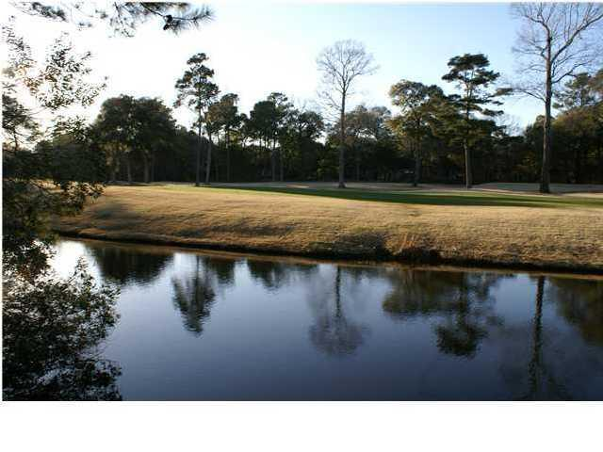
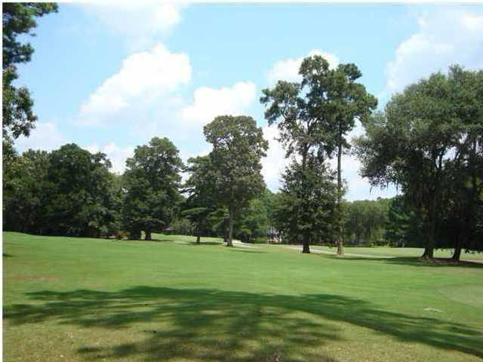
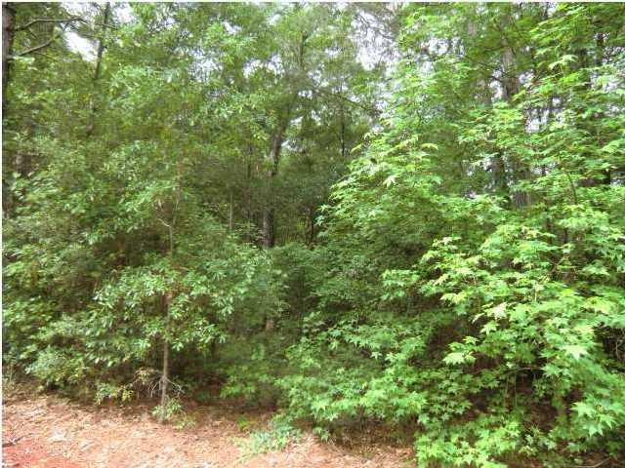
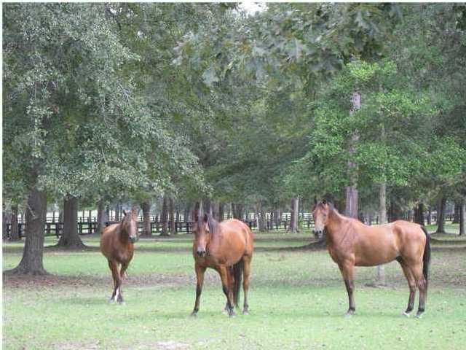
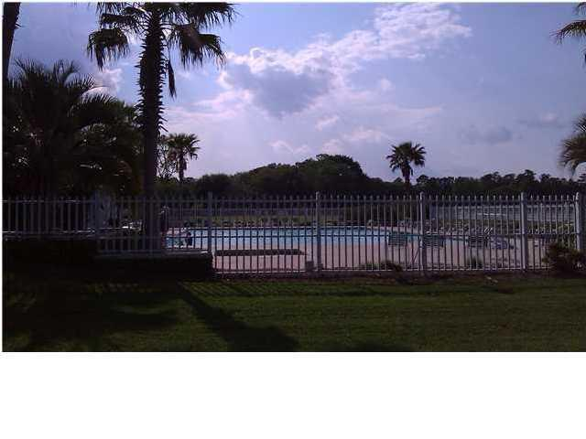
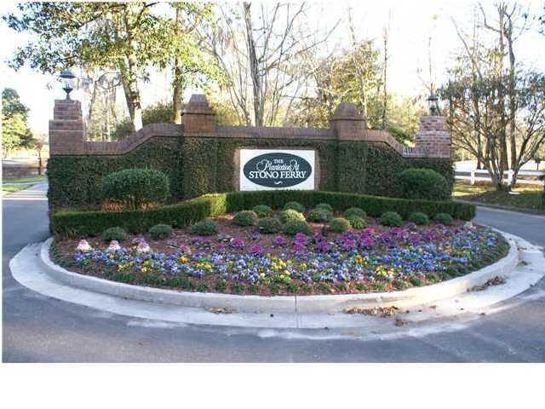


Water and Golf Course Views
Saint Ann Lane
Stono Ferry - Rural West Ashley
MLS# 1215299 - $160,000
Stunning golf course views of 15th and 16th fairways at the award winning Links at Stono Ferry.
Lovely half-acre lot on a quiet cul-de-sac in the Stono Ferry community. Amenities include junior olympic pool, playground, polo fields, and is home of the Charleston Cup Steeple Chase.
Buyer to pay transfer fee of 1/4% of purchase price at closing.
Caprice Atterbury
Broker-in-Charge
Complete Action Real Estate Services, Inc.
843-425-9817 - Mobile
caprice@caresrealestate.com

