Slide 1

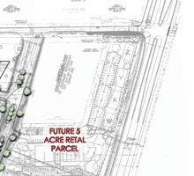
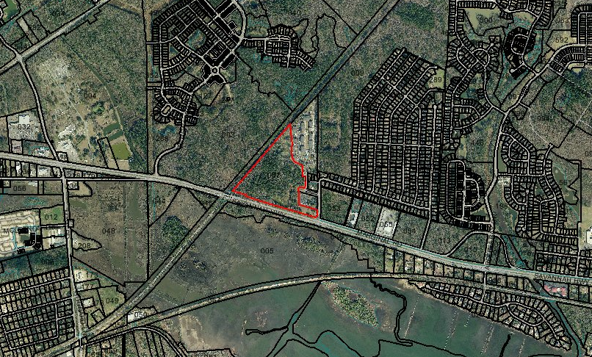
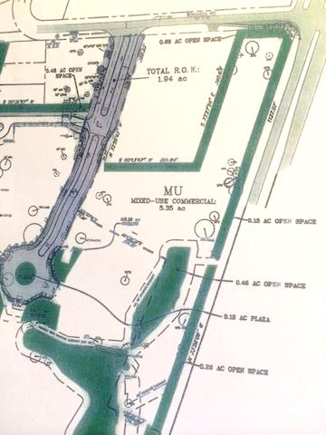


PRIME SAVANNAH HIGHWAY SITE READY FOR DEVELOPMENT
Commercial Frontage Land for Sale
Prime Retail/Office Land ready for development.
Sewer/Water and Power are available and this site is shovel ready. Contiguous to well-established apartment complex and residential subdivisions, this property is prime for a developer representing retail and professional service tenants. Proposed site plans are available. Multiple commercial scenarios exist for your review. Potential for a traffic light to be installed on Savannah Highway (17 South). Presently zoned Planned Unit Development by the City of Charleston and approved for mixed-use development (Multi-Family Prohibited). The Flood Zone is AE with appropriate drainage. This area has an excellent freeway system with 1,760 lineal feet of frontage along Savannah Highway and 78.32 lineal feet of frontage along Bonanza Road. Next door to Ponderosa residential community.
Acres: 5.35
Address: SAVANNAH HWY
Area: CHS-W.Ashley outside I-526 to Rantowles
Category: details
City: CHARLESTON
County: Charleston
Listing ID: 1400572
Listing Price: $200k/Acre
Property Name: HIGHWAY 17 S INVESTMENTS LAND

