Slide 1
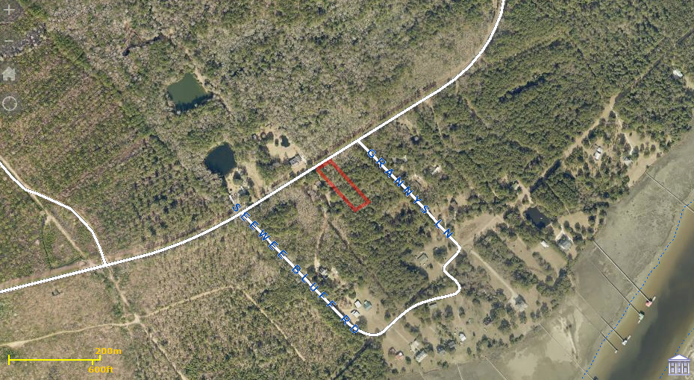
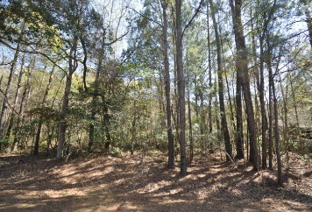
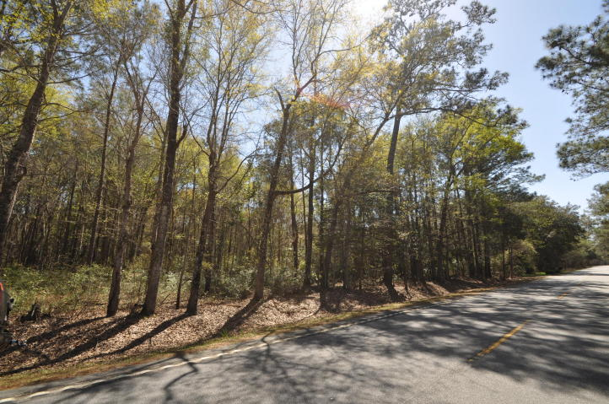
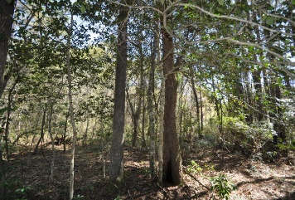
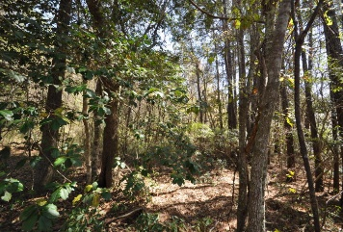

Get ready to build your dream home today
0 Seewee Road
Awendaw, SC 29429 ~ MLS# 15008247 ~ $113,900
Build your dream home on this beautiful peaceful and quite wooded 1 acre lot just 10 minutes from all the conveniences of Mt. Pleasant and 30 minutes from historic downtown Charleston. This 112x400ft lot is located in an X flood zone, the cost for flood insurance will be minimal if any and has been permitted by DHEC for a septic system. Francis Marion National Forest, Cape Romain Wildlife Refuge, The Center for Birds of Prey, The Awendaw Passage, Bulls Island Ferry and the annual Crab festival all call Awendaw home. This lot location is far enough away to be peaceful, serene and quite, but conveniently close to all the shops, restaurants, hospitals, schools and more. Call listing agent for all details and get ready to build your dream home today. Proposed Construction plans coming soon.
Monique Mixson Monique@mattoneillteam.com 843-709-4075

