Slide 1
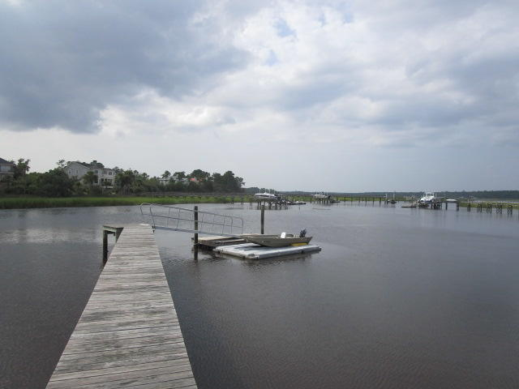
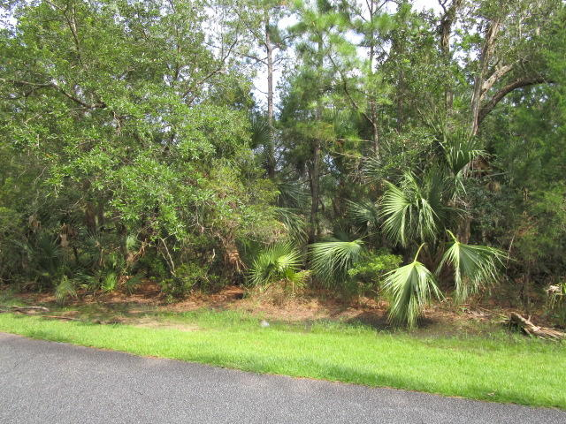
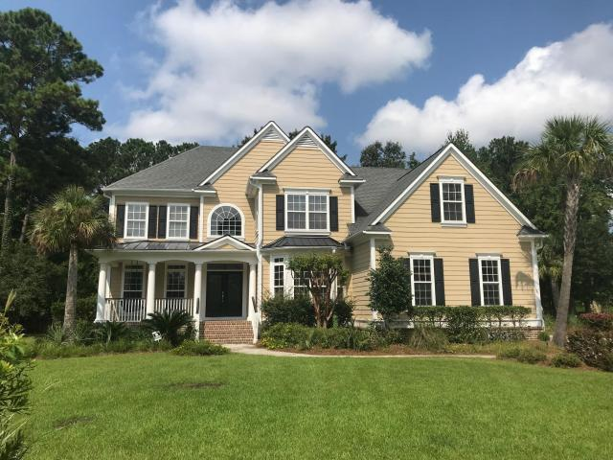
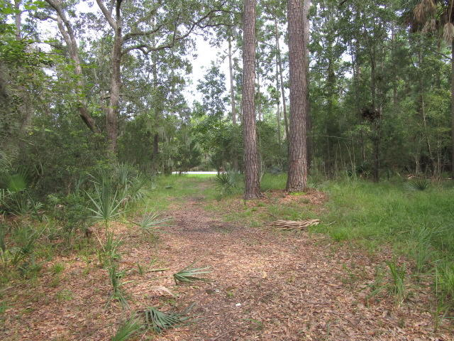
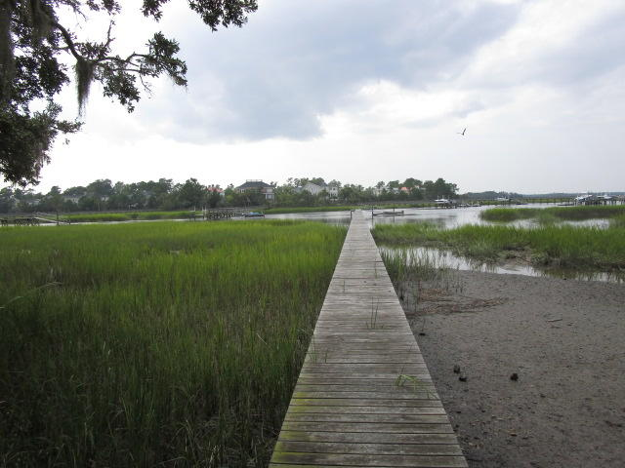
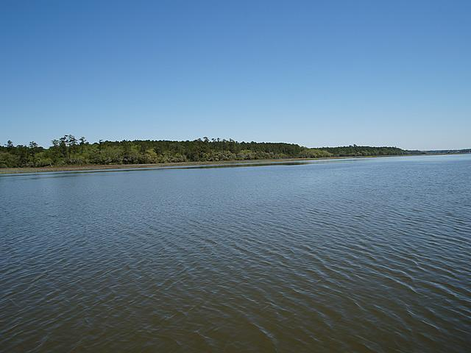
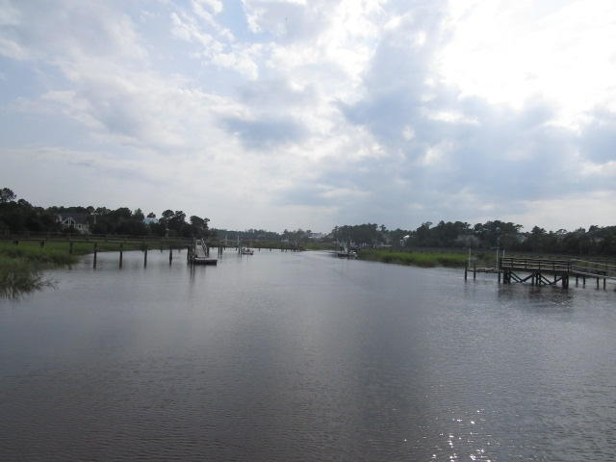
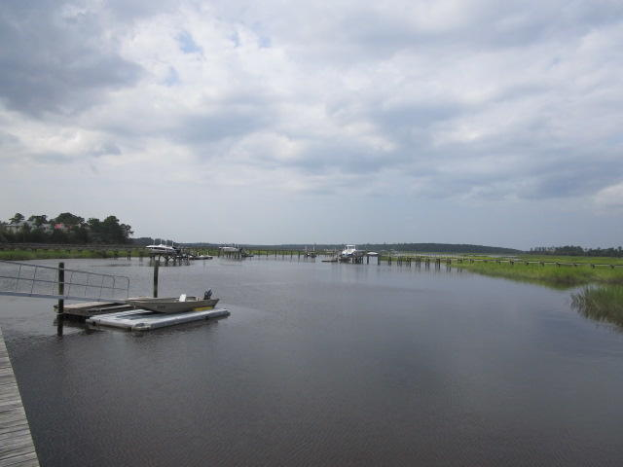
Owner is Motivated!
0 Station Point Court
Darrell Creek
Mount Pleasant, SC 29466
MLS# 18023716
$649,000
Over a half acre deep-water lot with a private dock and floater, & gorgeous water views of Darrell Creek & the Wando River. Close to shopping, schools, beaches, employment, & restaurants.
Charles Salmonsen
M (843) 224-0300 | O (843) 388-6613 | charles@salmonsen.com
Salmonsen Realty | 864 Lowcountry Blvd Ste B | Mt Pleasant, SC 29464

