Slide 1
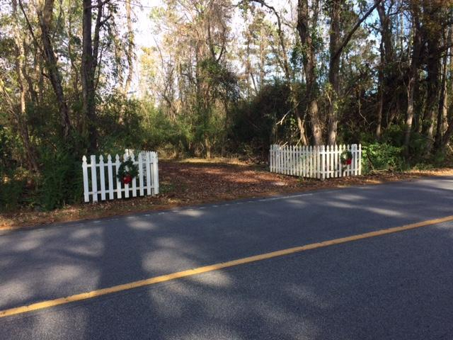
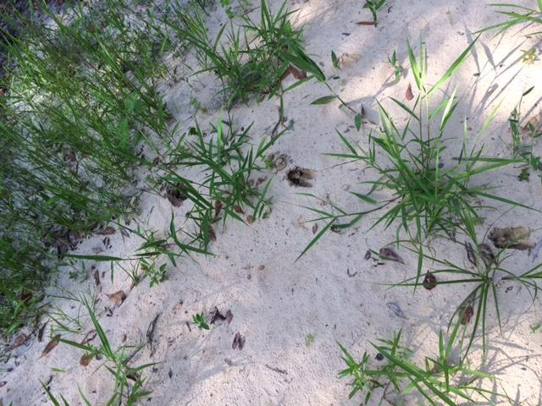
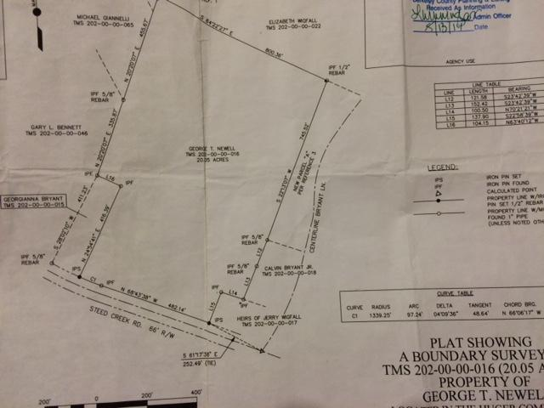
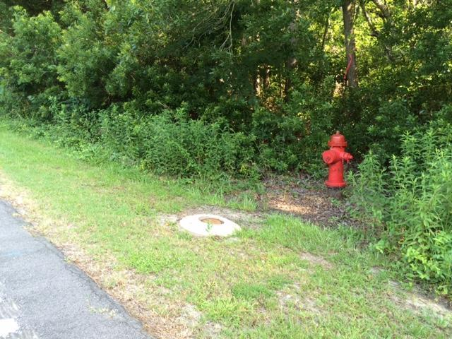
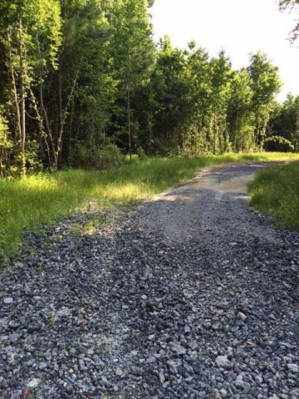
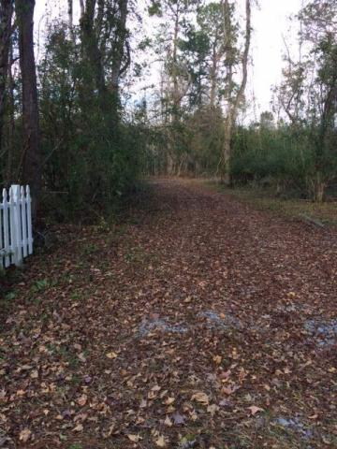
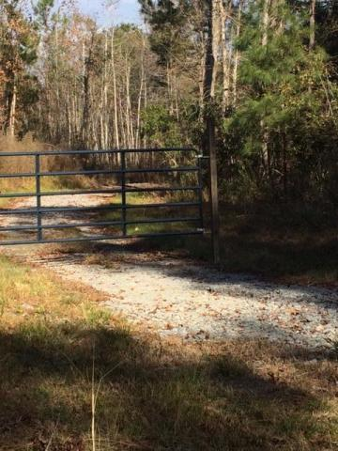
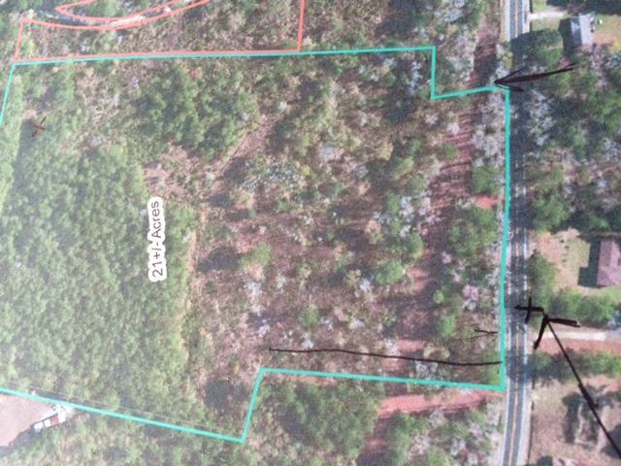
20 Secluded Acres Waiting For You!
Price Reduced!
0 Steed Creek Road
Huger, SC 29450 ~ MLS# 16031688 ~ $229,000
With just over 20 acres, there is unlimited potential in this parcel. Plenty of room for a private estate, horse farm, agricultural endeavors or family compound. Agricultural/residential zoning allows up to four homes on this property. Recent survey and some clearing with perimeter roads cut in and large open fields. Berkeley county utilities and city water at road. Very tranquil and private with lots birds and wildlife. Minutes to Quimby Creek Boat landing and approx. 25 minutes to Towne Center. Buyer is responsible for all Due Diligence including but not limited to zoning, schools, perk tests, taxes, etc.
Linda Kammel (843) 884-3901 O ~ (843) 670-0180 M
lindakammel@gmail.com
Old Dominion, REALTORS · 890 Johnnie Dodds Blvd · Mt Pleasant, SC 29464

