Slide 1
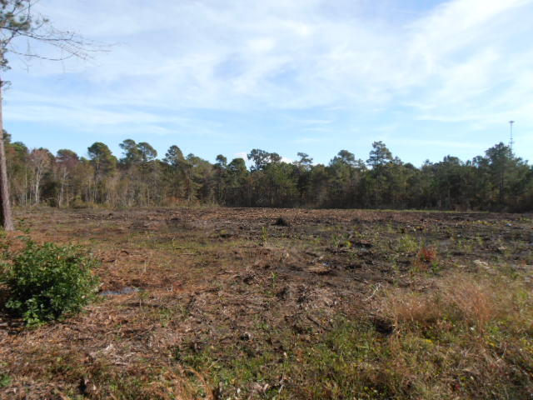
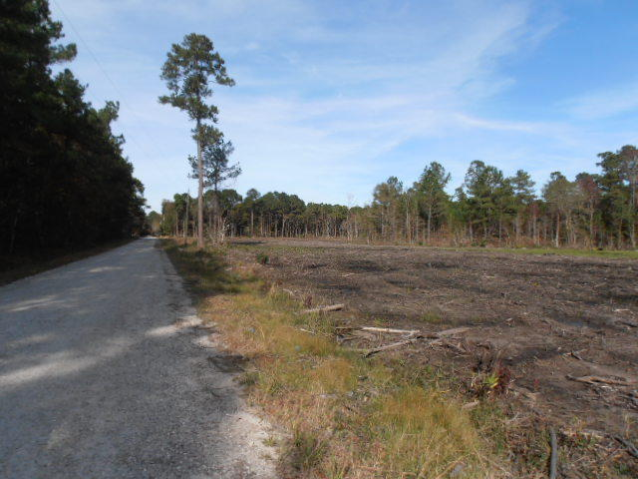
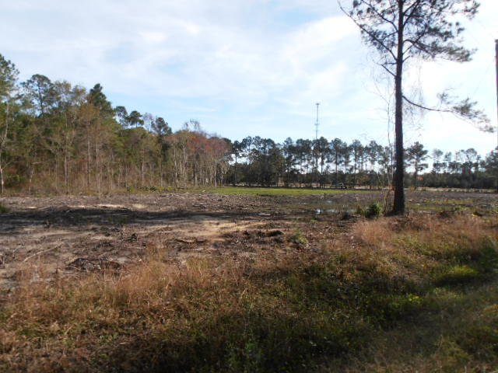
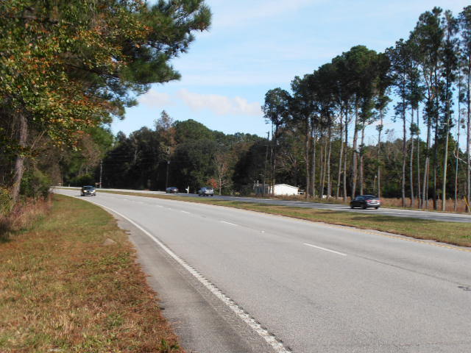
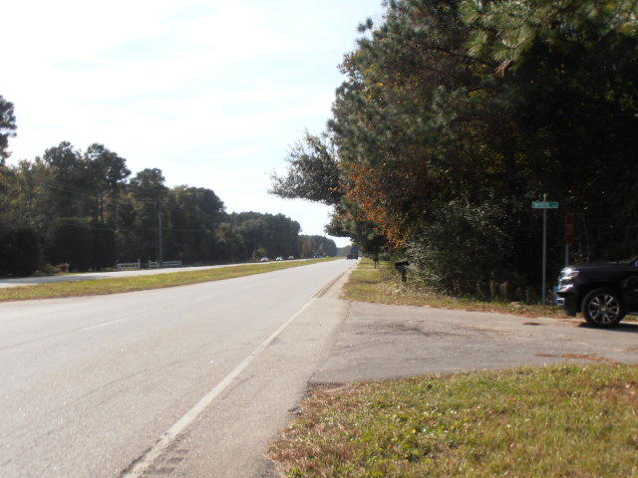
0 White Road
Brushland | Awendaw
MLS# 17019630 | $229,000
5.95 Acres Vacant Land
Corner of Hwy 17 & White Rd.
Good visibility.
The next area east of the Cooper that will be developed for commercial & residential use.
There is ingress/egress from Hwy 17 North turning into White Road & into the property.
Charles Salmonsen
M (843) 224-0300 | O (843) 388-6613 | charles@salmonsen.com
Salmonsen Realty | 864 Lowcountry Blvd Ste B | Mt Pleasant, SC 29464

