Slide 1

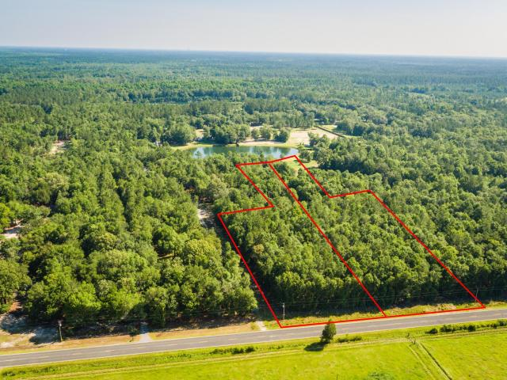
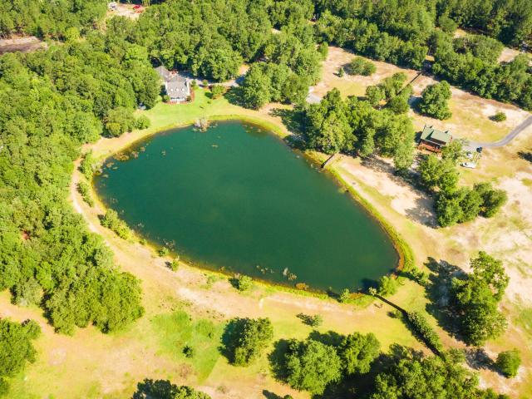
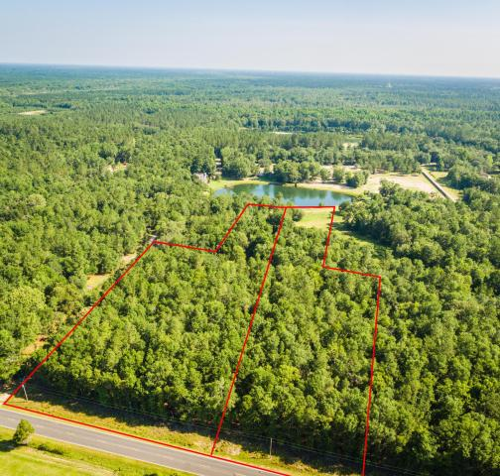
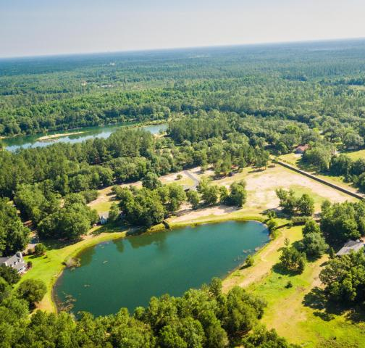
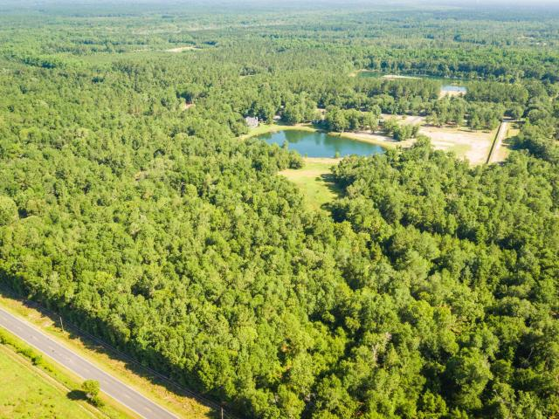

Build your dream home
On 10.65 acres with a pond
Jacqui Swain
Office (843) 871-1710
Mobile (843) 295-9484
jacquiswainc21@gmail.com
www.JacquiSwain.c21.com
0 Wire Road Lazy J ~ Dorchester, SC 29437 ~ MLS# 18017073 ~ $122,500
2,451 sq ft
5 beds · 2 baths
Wonderful opportunity to build your dream home on 10.65 acres with 300 feet on the pond!
Enjoy the serenity and build your own oasis away from the hustle and bustle of city life, while only being an 1 hour from Downtown Charleston.
Zoned Residential, Manufactured and Agricultural A and B. Horses are allowed. Sale includes Two Contiguous parcels one with 5.51 acres and the other with 5.14 acres. One lot is partially cleared.
1000 feet frontage on Wire. rd. Possibility to sub divide into 1 acre parcels w/ 150 feet widths. Variety of uses and Possibilities.
Century 21 Expert Advisors | 100 Seven Oaks Lane | Summerville, SC 29485-8514

