Slide 1

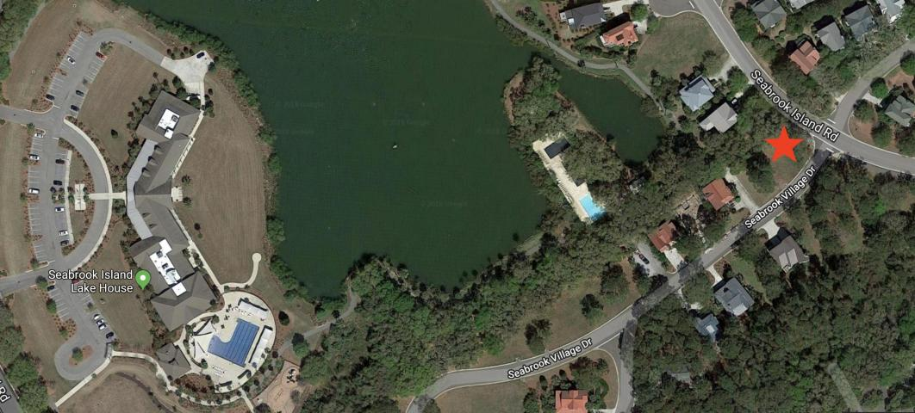
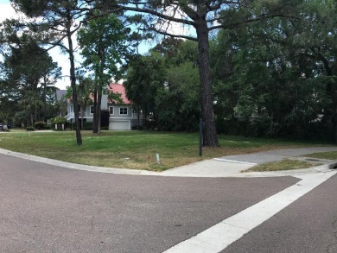
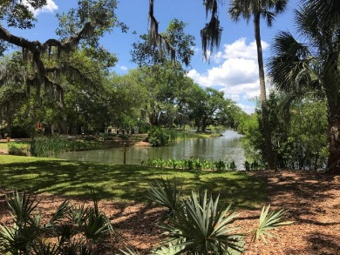
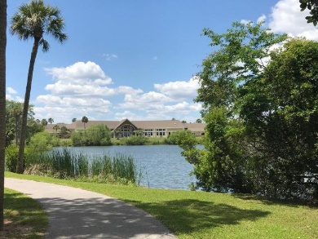
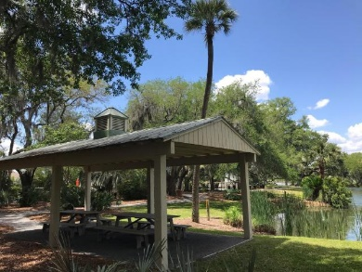
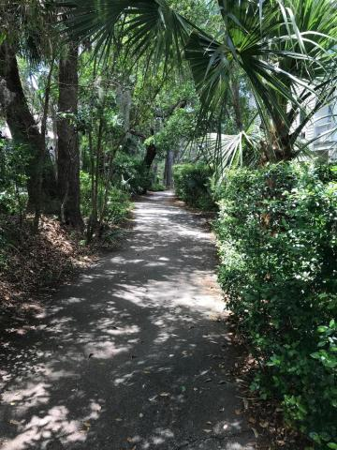
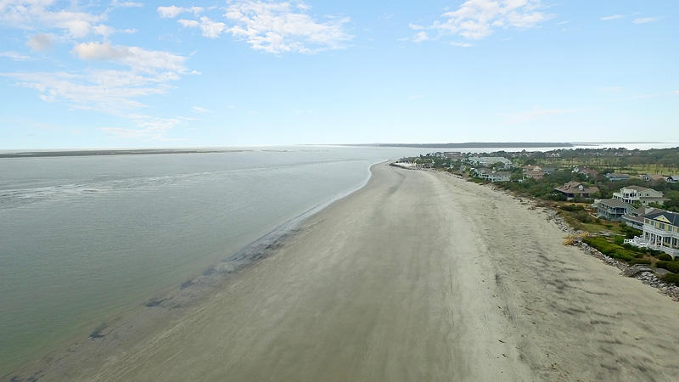
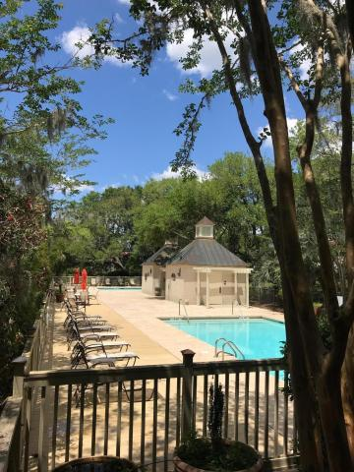


Least Expensive Home Site on Seabrook Island & It's a Great One!
0 Seabrook Village Drive
Seabrook Island, SC 29455 · MLS# 18012682 · $45,000
Wonderful corner home site in the Village at Seabrook located steps away from the Village pools on Palmetto Lake, the Lake House fitness center and additional pools, the tennis center, and the equestrian center. Situated beside a double lot with a walking trail right behind, this home site won't have any future builds adjoining it. Build your dream home and enjoy all of the Seabrook Island amenities and beautiful beach!
Lee Lindler Cell (843) 637-0803 | LeeL@NVRealtyGroup.com
NV Realty Group | 1900 Seabrook Island Rd | Johns Island, SC 29455
LeeLindler.NVRealtyGroup.com

