Slide 1
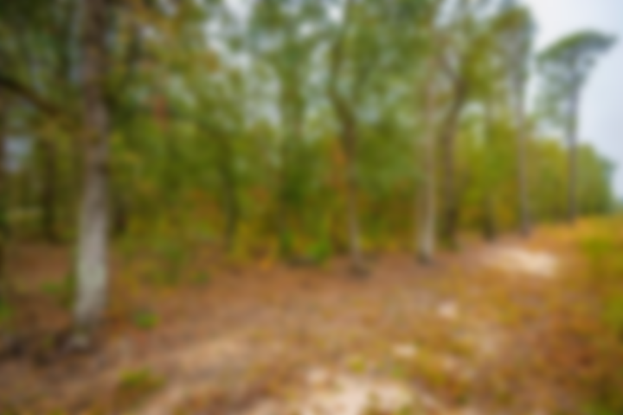
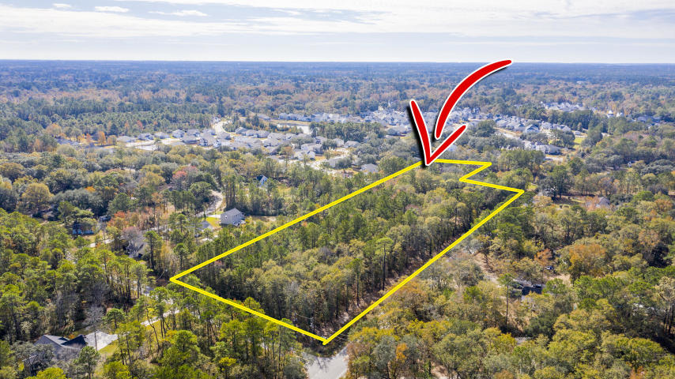
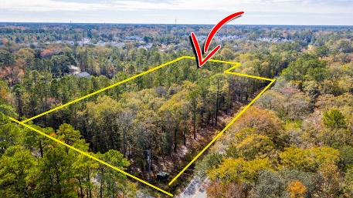
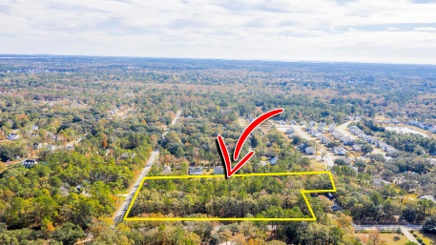
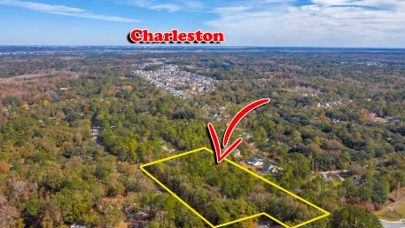
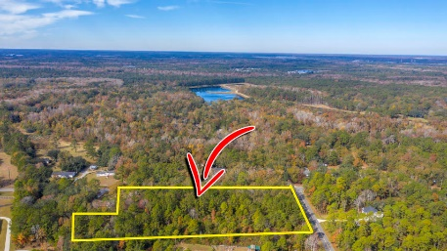
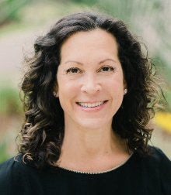

Dream Lot for your Dream Home!
0 Brownswood Road
Johns Island, SC 29455 | MLS# 19032537 | $150,000
This parcel offers island privacy combined with the convenience of being less than 30 minutes from downtown Charleston. Build your dream home on 4.4 quiet, wooded acres just minutes from Maybank Highway, restaurants, shopping and parks. Also, just a short drive to Kiawah and Seabrook Beaches.
Marian Kilpatrick
(843) 633-1164
marian.kilpatrick@carolinaone.com
www.mariankilpatrick.com
Carolina One Real Estate
2713 Highway 17 North
Mt. Pleasant, SC 29466

