Slide 1
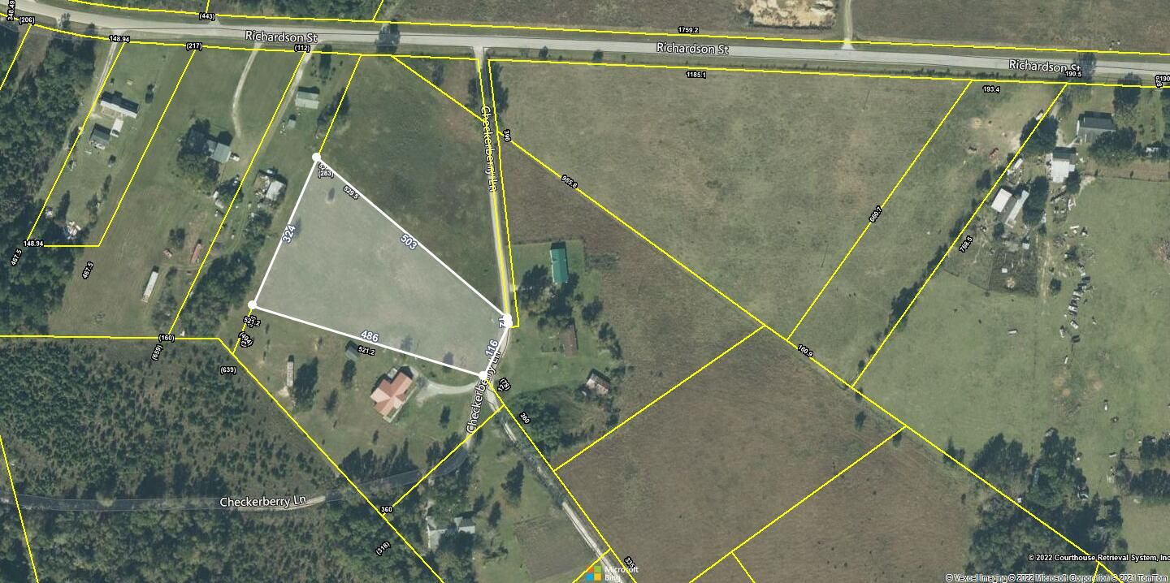
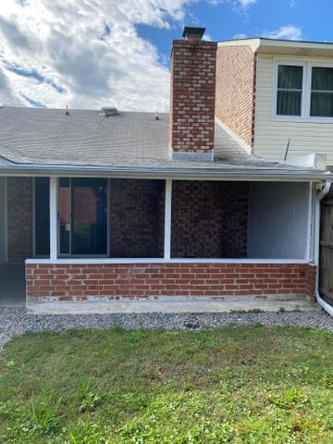
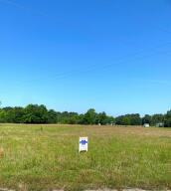
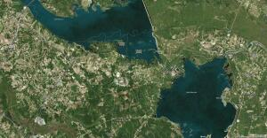
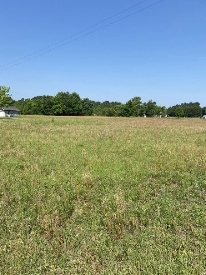


0 Checkerberry Road Eutawville, SC 29048 | MLS# 22010967 | $65,000
Open House Saturday
12:00 until 4:00
Great Piece Of Land, 3 Acres. Perfect For Your New Home.
Open House Saturday 8/24/19
12:00 until 4:00
Great piece of land, 3 acres. Perfect for your new home. Beautiful level and high 3.0 Acre lot ready for you to build your new home. Near Lake Marion, 5.5 miles (8 min) to Bell's Marina. 30 minutes to Volvo.
James Hopkins
(843) 708-5930
James.Hopkins@AgentOwnedRealty.com
AgentOwned Premiere Group
1800 Trolley Rd
Summerville, SC 29485

