Slide 1
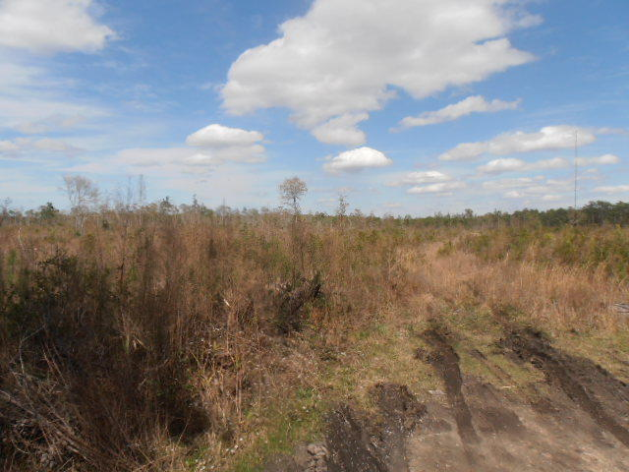
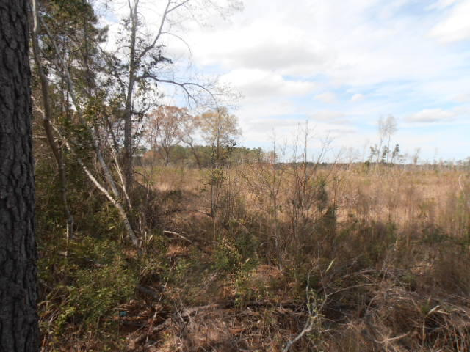
Hunters Paradise!
75.92 acres +/- of vacant land
0 Deas Hill Rd
McClellanville, SC 29458
MLS# 20012908 | $499,299
Owner is anxious, SUBMIT ALL OFFERS
6 lots are included in this package deal. Tract C Old Tract 19 (TMS#764-00-00-495), Tract A (TMS#764-00-00-498), Lot 1 (TMS#764-00-00-363), Tract B Old Tract (TMS#764-00-00-387, 18.00 acres Society Road (TMS#764-00-00-388), & Tract D (TMS#764-00-00-398). This would be a great candidate for a conservation easement. It would save the Buyer thousands in tax savings depending on the tax bracket. In 2013, the parcels were treed & replanted by a Certified SC Forester. Approximately 45,000+ trees on average with silviculture roads in place. Attached parcel aerial shows silviculture roads (green) in place as well as access points to the property. Note TMS#'s 764-00-00-007, 016, 017, & 018 are not included in the sale of the property.
Charles Salmonsen
M (843) 224-0300 | O (843) 388-6613 | charles@salmonsen.com
Salmonsen Realty | 864 Lowcountry Blvd Ste B | Mt Pleasant, SC 29464

