Slide 1
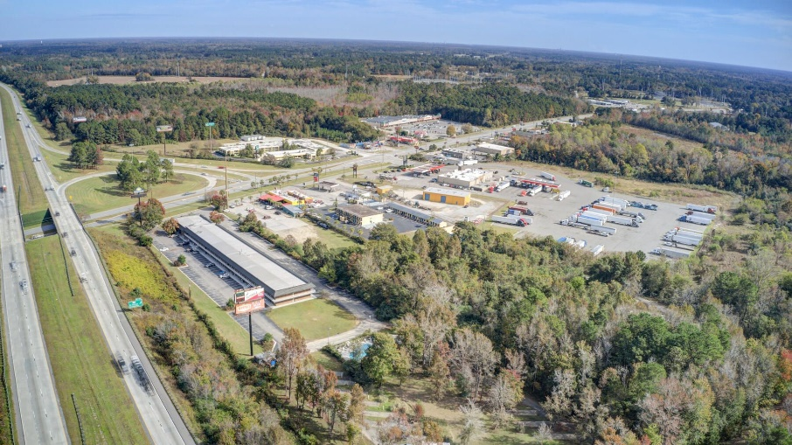
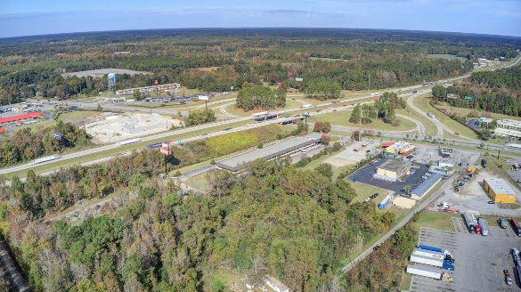
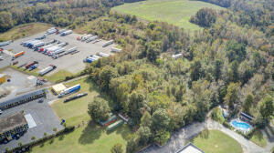
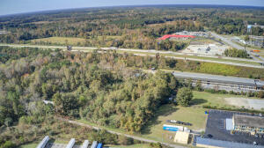
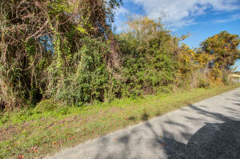
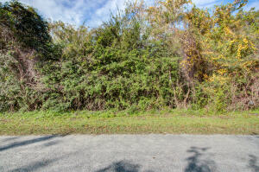
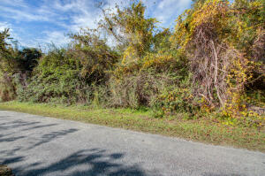



PRIME COMMERCIAL LOT, 1.10 ACRES OFF I-95
0 Doyle Street
Saint George, SC 29477
MLS# 22027285
$165,000
1.1 Acres
1.1 Acres in a PRIME LOCATION, OFF I-95! Commercially zoned property right off I-95 and Hwy 78! This property is zoned and will make a great spot for; personal services, business services, general retail, general commercial, service commercial, restaurants, gas stations and lodging. Located on the east side of I-95, where all of the current brick and mortar companies are. Property is wooded and will need to be cleared. Utilities are located at the street and will need to be brought to property. Utilities are not located, however, may be at adjacent commercial property to tie into. Owner is also open to leasing the property.
Nick Mazzilli
(843) 640-5575
nick@nickmcharleston.com
www.mavenrealtysc.com
Maven Realty
2180 McMillan Ave
#71672
Charleston, SC 29405

