Slide 1
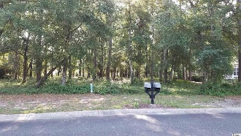
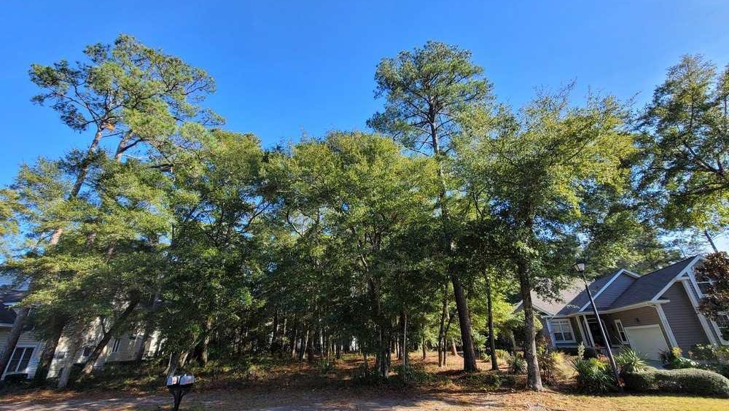
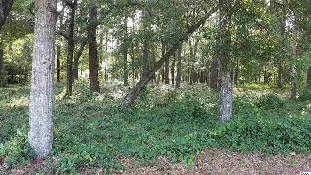
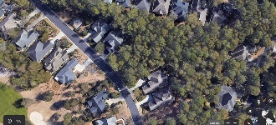
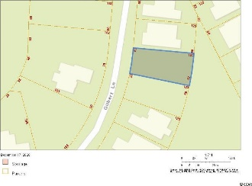
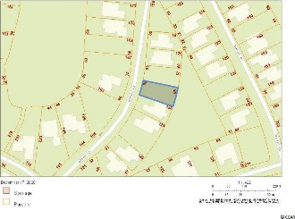
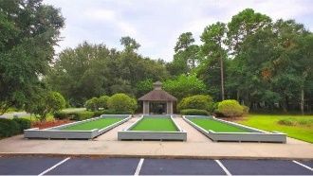
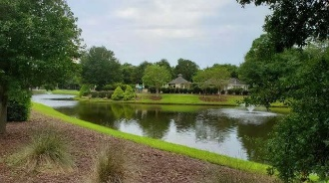
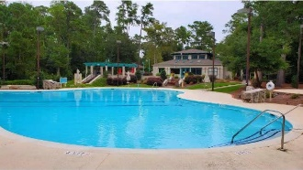
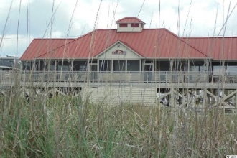



Highly Desirable Double Lot
Lots 567 & 568 Gilbert Dr
Tidewater Plantation | North Myrtle Beach, SC 29582
MLS# 2020137 | $90,500
Tidewater Plantation is a golf/Intracoastal Waterway/beach community. The Bluffs Section adjoins the Cherry Grove Marsh and peaks at the Atlantic Ocean. This highly desirable double-lot is situated on Gilbert Dr., approximately one block from the Cherry Grove Marsh and bordering a secluded wooded area in the rear that will not ever be built on, affording maximum residential privacy. This is one of the few luxury buildable lots left in The Bluffs; you can even hear the ocean from this magnificent location. Long-term rentals are allowed in the Bluffs side; so, at this compelling price, flex-building options and low HOAs and taxes, this amazing, rare residential lot is an excellent investment as well as being sought after for a vacation or permanent home. No flooding ever! There is no time frame to build. Tidewater-approved contractor list available. Approximately 1/3-acre lot: There is about 105 ft. of road frontage on Gilbert Dr. THE BLUFFS OF TIDEWATER IS BEING RAPIDLY BUILT OUT AS WELL. You must view! In addition to golf and being in an ICW community, Tidewater boasts many other rich, upscale amenities, including owners' beach cabana on the Cherry Grove Beach named the 11th best in the natiion, pools & spas, clay & hard-surface tennis courts, pickle ball, bocce, horseshoes, amenities center, fitness center, driving range and putting green, 24-hour gated manned security, and clubhouse with bar & restaurants. There is even a complimentary gated storage yard for boats, campers, recreational vehicles and the like. The on-site, convenient HOA building has rooms for business and other meetings and events and a lending library. There are many clubs and activiites year round. In Tidewater, you can do it all, or just relax in the luxurious Tidewater lifestyle. The Bluffs of Tidewater is contiguous along the Cherry Grove Inlet where the Atlantic Ocean rolls into the marsh. This lot, therefore, is highly sought after by the builder, investor or soon-to-be home-owner who desire to acquire an extraordinary golf/ICW/beach community property at today's market prices to be built later. Tidewater itself is on a tree-lined road to oceanfront Anne Tilghman Boyce Coastal Reserve, a nature conservancy, including Waties Island, with access for managed recreational use. Tidewater, a historic plantation, is on an elevated peninsula of live oaks and southern pines between the Intracoatal Waterway and the Cherry Grove Inlet to the Atlantic Ocean. The plantation also preserves the unique look of its own origins. It is close to the beach, shopping, entertainment, medical services, outstanding schools and parks and access to major highways. The jewel in the crown of the development is that private owners' beach cabana on the wide, white sands of the Cherry Grove Beach, just a few minutes drive. This charming, large double lot especially enjoys a lovely, indigineous peaceful environment, along with the excellent reputation of the Tidewater Golf Course, the Pebble Beach of the East, and the nearby Cherry Grove Marsh. Tidewater Plantation, in one of the U.S.'s top-10 beach towns, North Myrtle Beach, truly reflects a "way of life." Do not let this singular double-lot get away. Welcome to the the best of the beach on Gilbert Dr. in the Bluffs of Tidewater Resort.
Video Tour: https://www.youtube.com/embed/Qsyl5MJEVBM
Connie Ross-Karl
702-306-2643
conniesross@aol.com
Ronnie Nichols
Realtor
Broker in Charge
NEW WAY PROPERTIES MYRTLE BEACH

