Slide 1
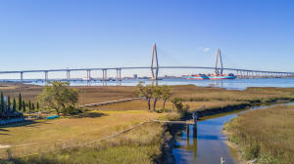
BUILD YOUR DREAM HOME!!
WATERFRONT LOT, INCREDIBLE DOWNTOWN VIEWS
MINUTES TO DOWNTOWN
0 Harbour Watch Way
Harbour Watch | Mount Pleasant, SC 29464 | MLS# 24015091 | $839,000
A perfect location for this waterfront lot
An exceptionally easy drive to downtown Charleston and access to all of Mt Pleasant without having to deal with a lot of the traffic
Great views of the Ravenel Bridge and the city and harbor
Not many of these around so please take a look
Nathan Delpino
843-200-2721
nathan.delpino@gmail.com
www.makingcharlestonhome.com
Harbourtowne Real Estate
672 Marina Drive, Ste 110
Daniel Island, SC 29492

