Slide 1
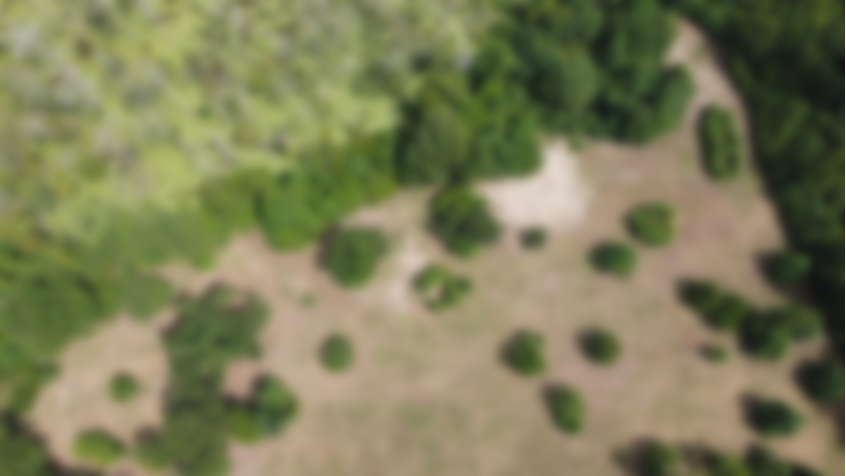
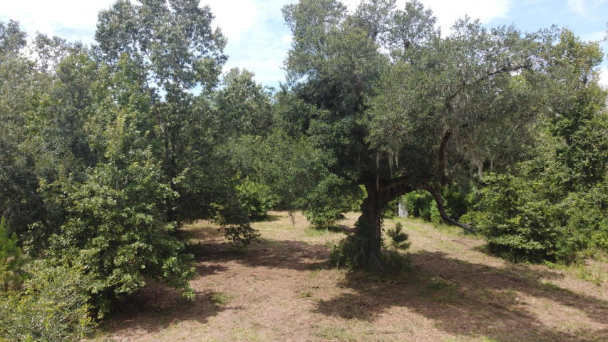
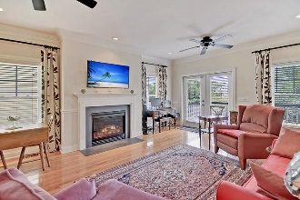
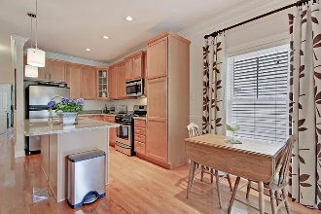
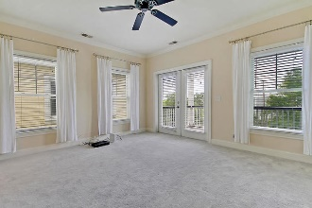
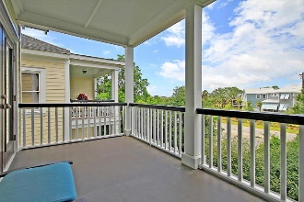
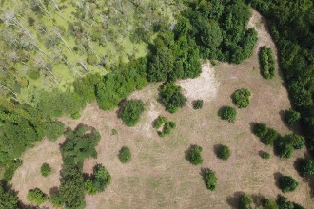
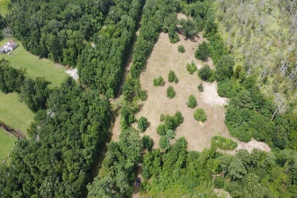
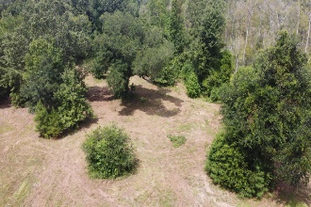
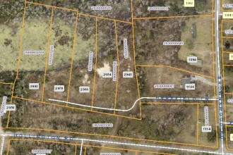


Five Johns Island Homesites
0 Harefield Lane
Johns Island, SC 29455 | MLS# 20022615 | $375,000
This beautiful Johns Island property is over 7 acres in total, and is already subdivided into five homesites that have been rough graded and have septic permits in place. City water is available from St. Johns Water Company. Located in the heart of Johns Island only minutes away from the Maybank Highway corridor, these large homesites will make a pleasant small neighborhood only 9 miles to historic downtown Charleston and 15 miles to Folly Beach.
The listing includes TMS #'s: 280-00-00-289, 280-00-00-290, 280-00-00-291, 280-00-00-292, 280-00-00-293
Lee Lindler
Cell (843) 637-0803 | lee@akersellis.com
Akers Ellis Real Estate LLC | 3730 Bohicket Road, Suite 5 | Johns Island, SC 29455
akersellis.com

